Slide 1

Resource Adequacy in the Pacific Northwest
Frank Afranji
Engineers for a Sustainable Future
May 11, 2021

Slide 2
What is the Northwest power pool
The Northwest Power Pool (NWPP) Corporation assures Member organizations achieve maximum benefits of coordinated operations
Core values: customer-driven, relationship-based, independent and operating with great integrity

Slide 3
What is the Northwest power pool
The NWPP Membership is a voluntary organization and is made up of the following members:
Members include:
Alberta Electric System Operator, Avangrid, Avista, BANC, BC Hydro,BPA, Calpine, Chelan PUD, Columbia Grid, Cowlitz PUD, Douglas County PUD, Energy Keepers, Inc. EWEB, Fortis BC, Grant PUD, Grid Force, Idaho Power, NaturEner, NorthWestern Energy, NV Energy, PacifiCorp, Pend Orielle PUD, Perennial Power, PGE, Powerex, Excel Energy, PSE, Seattle City Light, Snohomish PUD, Tacoma Power, TID, US Army Corps, Bureau of Reclamation, Western Area Power Administration

Slide 4
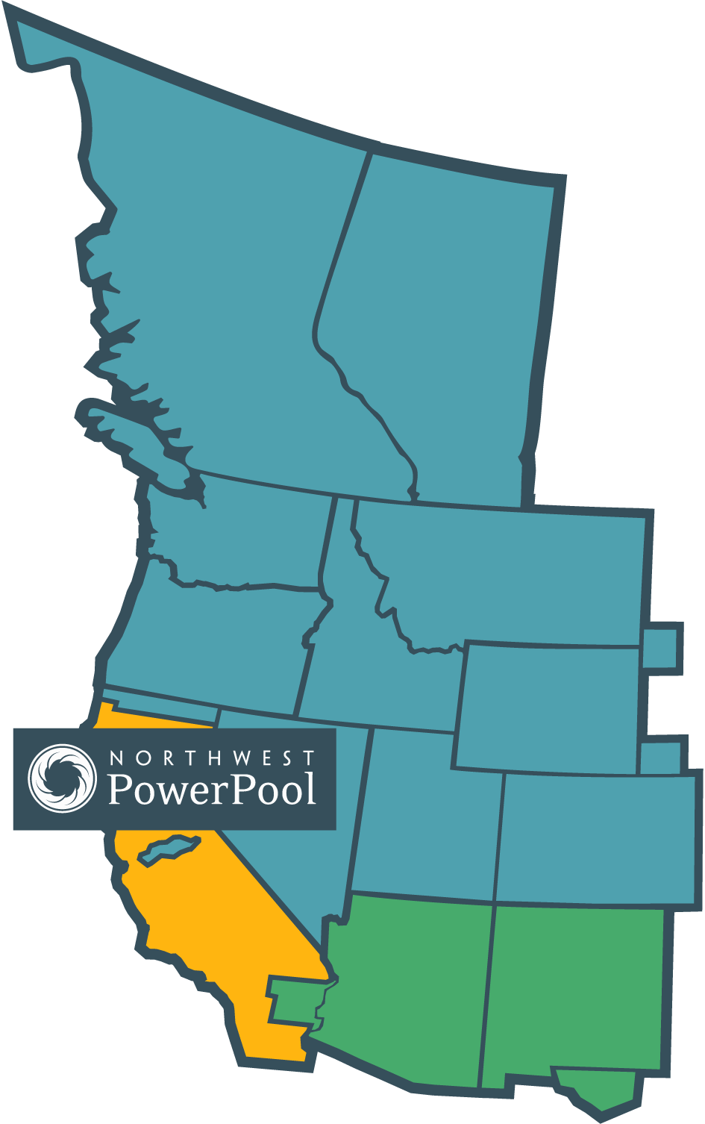
Reliability is the NWPP focus

Slide 5
A region in Transition
Coal retirements – losing firm resources when the region already has relatively tight load-resource balance
  3,000 MW of coal resources will come offline in the next two years
New state policies demand a shift to a cleaner electricity supply portfolio
  Oregon Senate Bill 1547 increased the state’s RPS to 50% in 2016
  Washington Senate Bill 5116 established goals of carbon neutrality in 2030 and carbon-free by 2045
Utilities acting on their own – combination of policy and economics
  Avista and Idaho Power have pledged 100% clean electricity by 2045
  PacifiCorp, PSE, Idaho Power proposing early retirements of coal

Slide 6
Why Northwest power pool
The Northwest Power Pool was established in 1941 and since that time has been coordinating resources to maximize efficient electricity production
The NWPP today coordinates a number of different programs essential to the reliable operation of the NW power grid including:
  Reserve sharing program
  Pacific Northwest Coordination Agreement
  Western Frequency Response Sharing Group
  Training

Slide 7
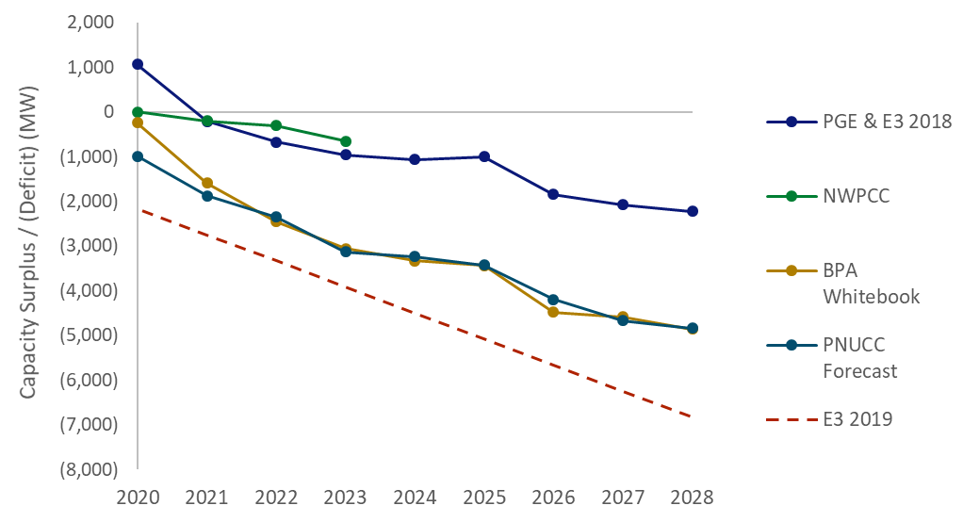
Multiple studies agree that the NW is approaching a period of capacity shortfalls
NW Capacity Surplus / Deficit in Recent Studies
US WECC Coal Retirement Scenarios
Note: WECC also publishes a resource adequacy assessment, but it focuses only on summer, whereas resource adequacy is primarily a winter issue for the Northwest
Note: Coal retirement scenarios developed by NWPP IRP Team. From research of announced and potential retirements from across the US WECC.

Slide 8
How did we get here
The NWPP report: Exploring a Resource Adequacy Program for the Pacific Northwest, 2019 identified planning deficiencies in NWPP’s footprint
  Planning is state- and utility-specific
  Planning entities use different standards and methods
  As a result, the region lacks insight into its overall resource situation
As a result of the 2019 Report, NWPP and its member utilities are moving forward to design a regional RA program for NWPP members

Slide 9
IRP needs assessment method
Data from IRP survey. Missing data filled in when possible.
Notes:
1-outage-in-10 years: Stochastic/probabilistic analysis.
2 of 3 utilities using an annual 2.4 hr LOLH target
1 public utility surveyed using 1-in-10 metriv
When viewed by peak load share, 1-outage-in-10 years and LOLP grow in popularity, largely at the expense of deterministic planning
Loss-of-load probability: Stochastic/probabilistic analysis.
2 utilities targeting 5% annually, 1 targeting 0.1 days per year
All IOUs doing some type of stochastic/probabilistic analysis
Percentile: P5 or P10 conditions (mix of hydro, loads, etc), often created via Monte Carlo simulation
Deterministic: Load/resource balance using fixed assumptions. May look at multiple metrics (annual energy, monthly energy, etc)
All utilities conducting deterministic or percentile planning are publics and hydro dominant. Most utilities looking at these metrics are concerned with energy as well as capacity.

Slide 10
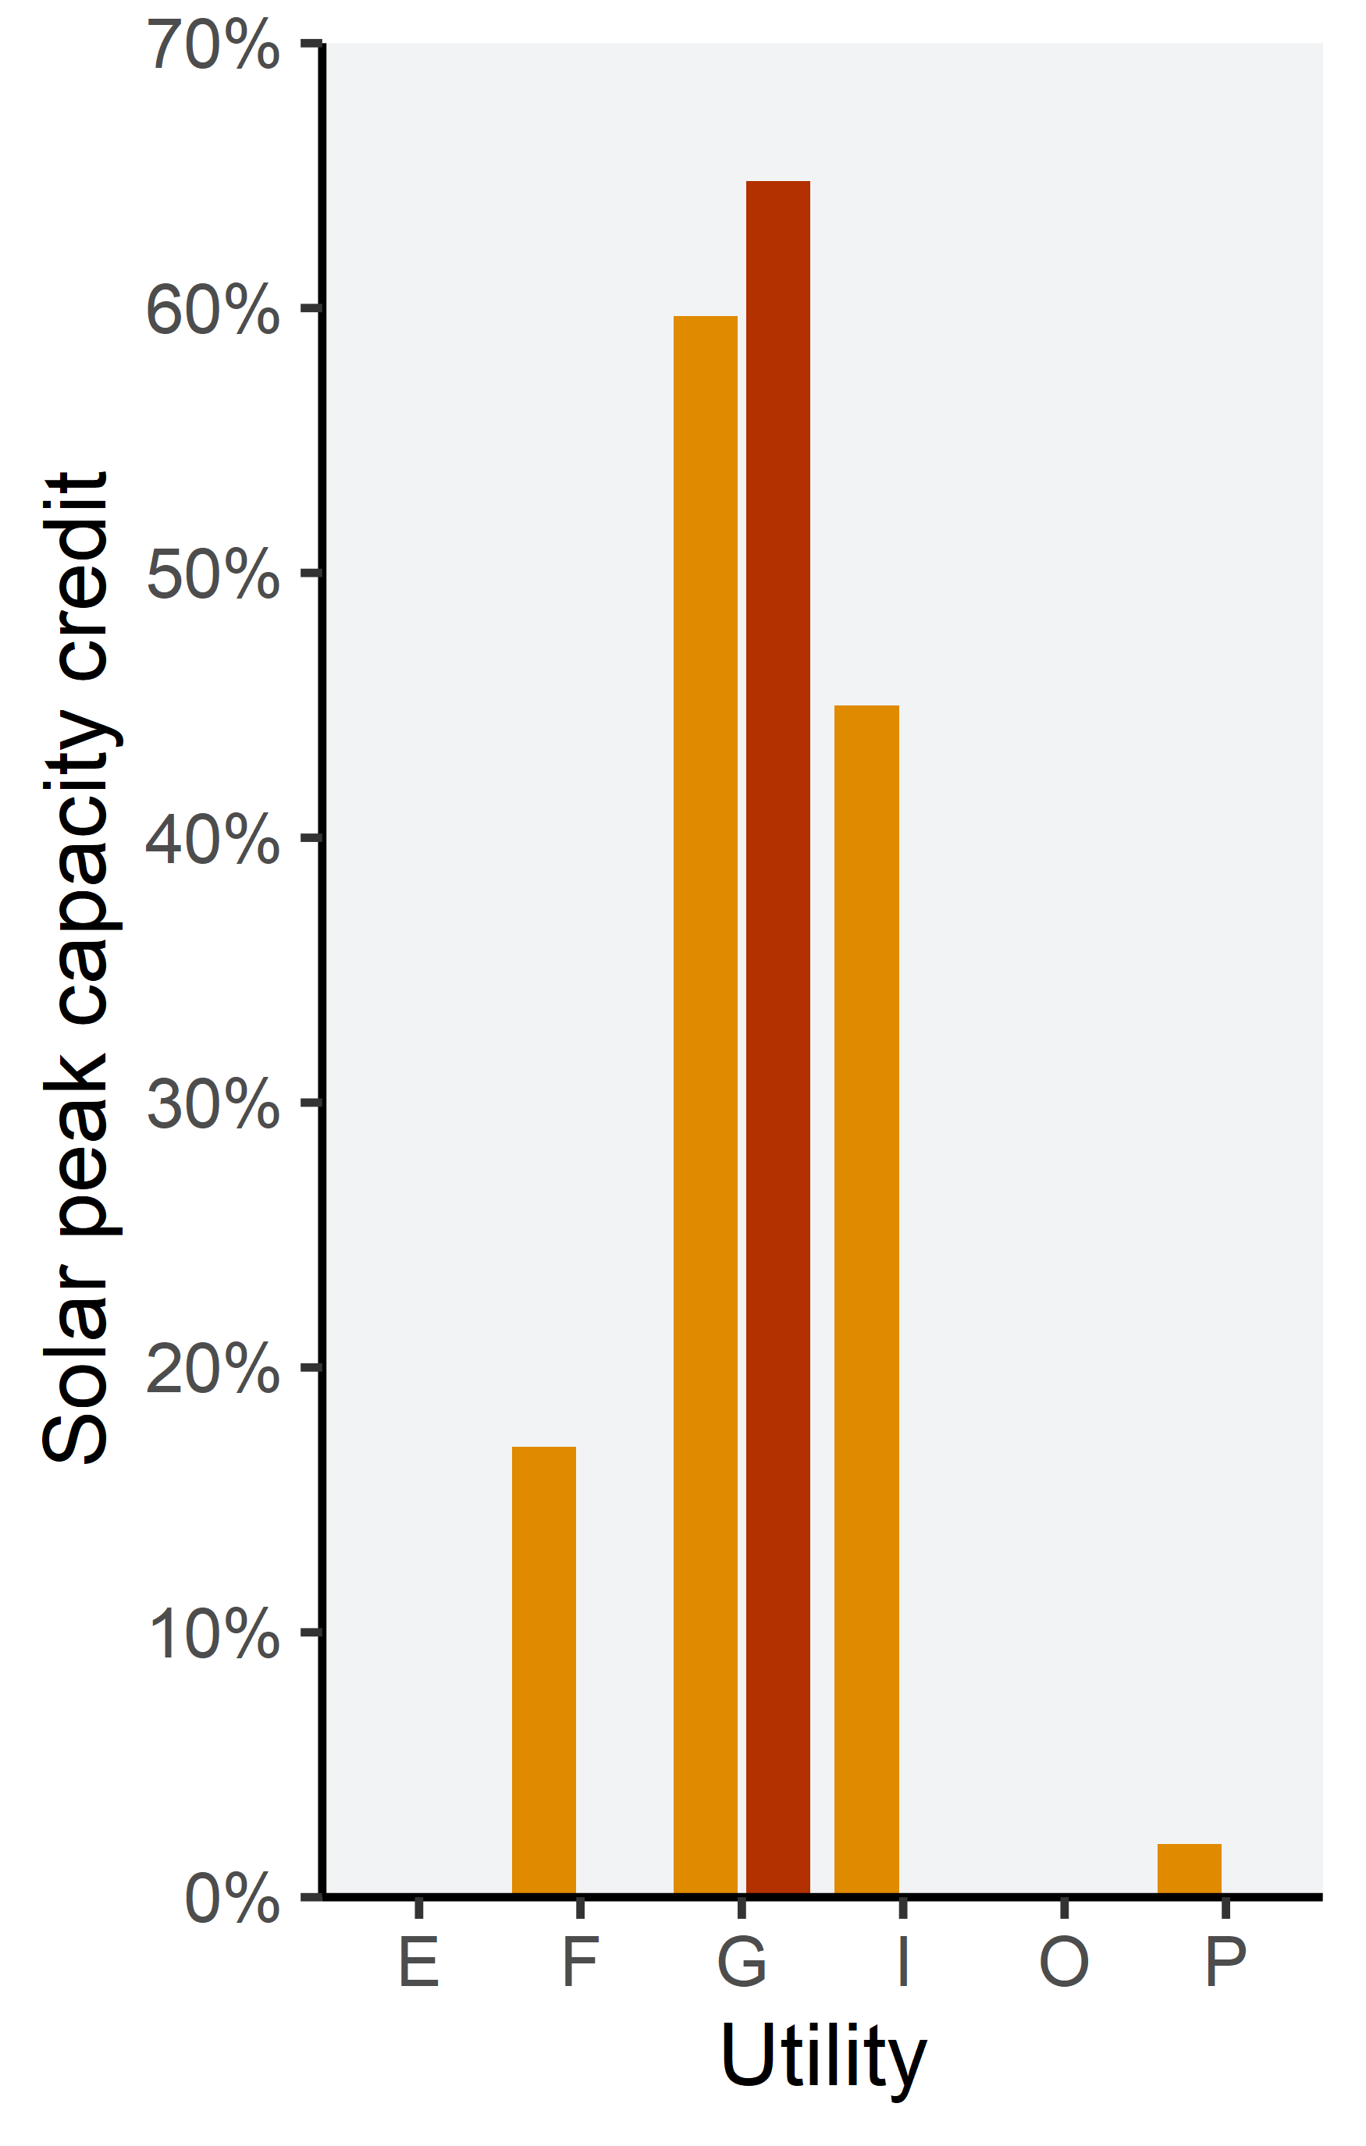
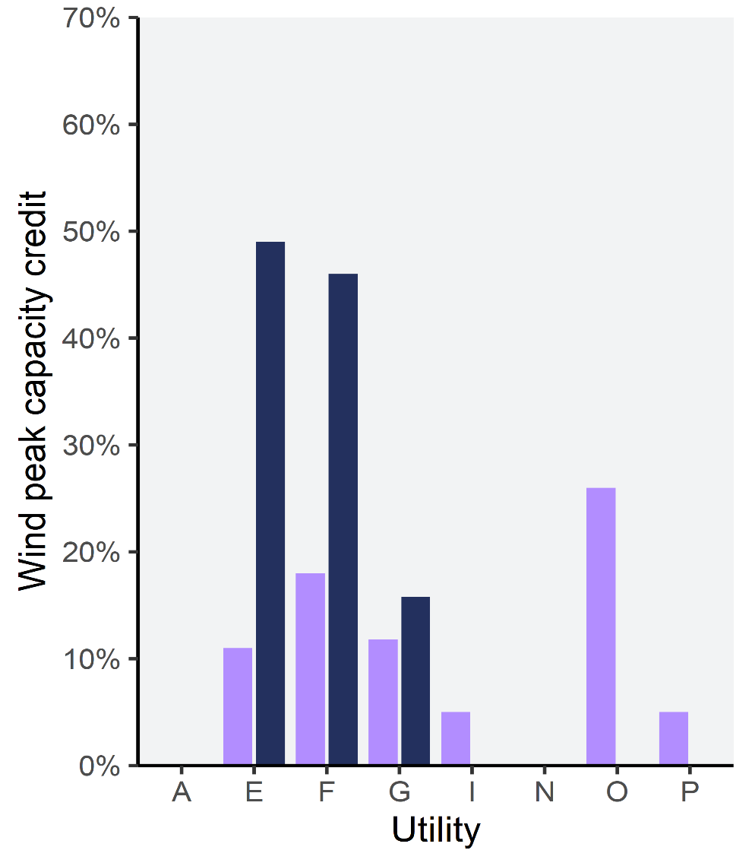
Wind & solar peak contribution varies
Depends on:
Location
Season of stress
Existing portfolio
Analysis method
Missing data excluded. Blanks are zeros.
Notes:
Location:
Some areas are sunnier and/or windier
Season/hour of stress:
Summer vs. winter
Is the sun set or still up
Existing portfolio:
1st MW or 1,000th MW
is there storage, etc.
Analysis method:
LCC, 90th percentile, etc.

Slide 11
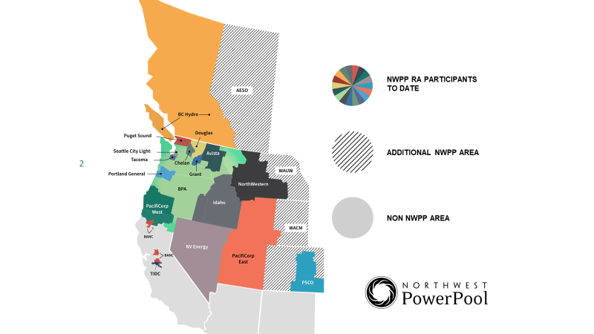

Slide 12
Diversity Benefits
Two main forms
TTW Two Main Forms TT
 | Winter | Summer
Noncoincident Peak | 80,000 MW | 86,000 MW
Coincident Peak | 76,000 MW | 84,000 MW
Approximate Estimated Load Diversity | 4,000 MW | 2,000 MW
Approximate Estimated Resource Diversity (3% NCP) | 2,400 MW | 2,600 MW
Total Diversity | 6,400 MW | 4,600 MW
Load Diversity
Resource Diversity

Slide 13

Key program design elements
                Adequacy/Reliability metric
                Governance
                Program operation and monitoring
                Supply/demand forecast metrics
                Resource eligibility
                Deliverability requirements
                Capacity determinations
                Outage rates
                Import qualifications

Slide 14
Benefits of a regional RA program
TRANSPARENCY
Regional approach to RA can inform a more comprehensive solution
Consistent standards among members
EFFICIENCY
Opportunity to access diversity benefits
CONFIDENCE
Confidence in regional RA needs

Slide 15

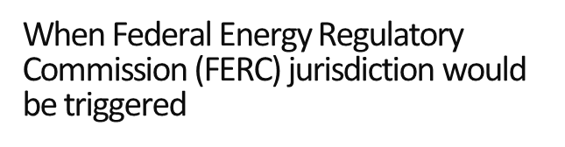
Overview of Project Timeline

Slide 16
Thank you!
https://www.nwpp.org/resources/

