Slide 1
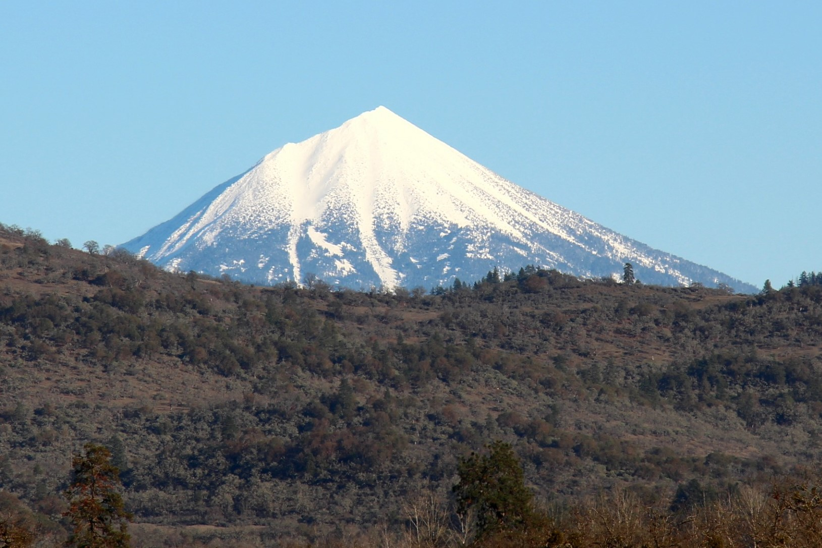
Oregon Climate Trends and Projections
Alan Journet
Cofacilitator, Southern Oregon Climate Action Now
alan@socan.eco; 541-301-4107

Slide 2
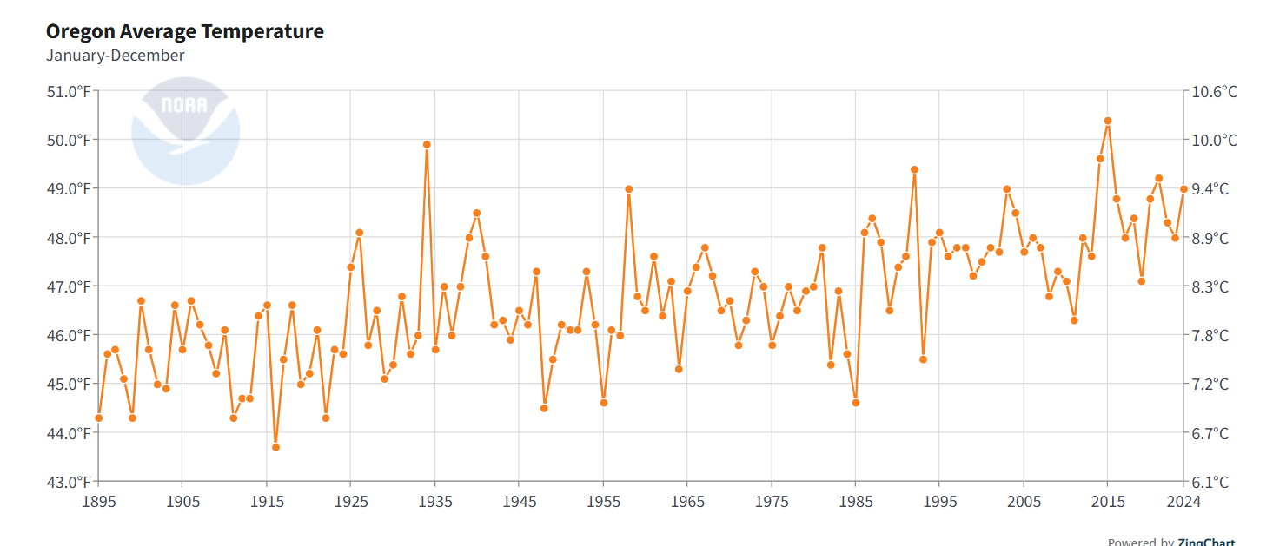
Oregon Historical Temperature Annual Average
1895 - 2024
https://www.ncei.noaa.gov/access/monitoring/climate-at-a-glance/statewide/time-series/35/tavg/12/12/1895-2024

Slide 3
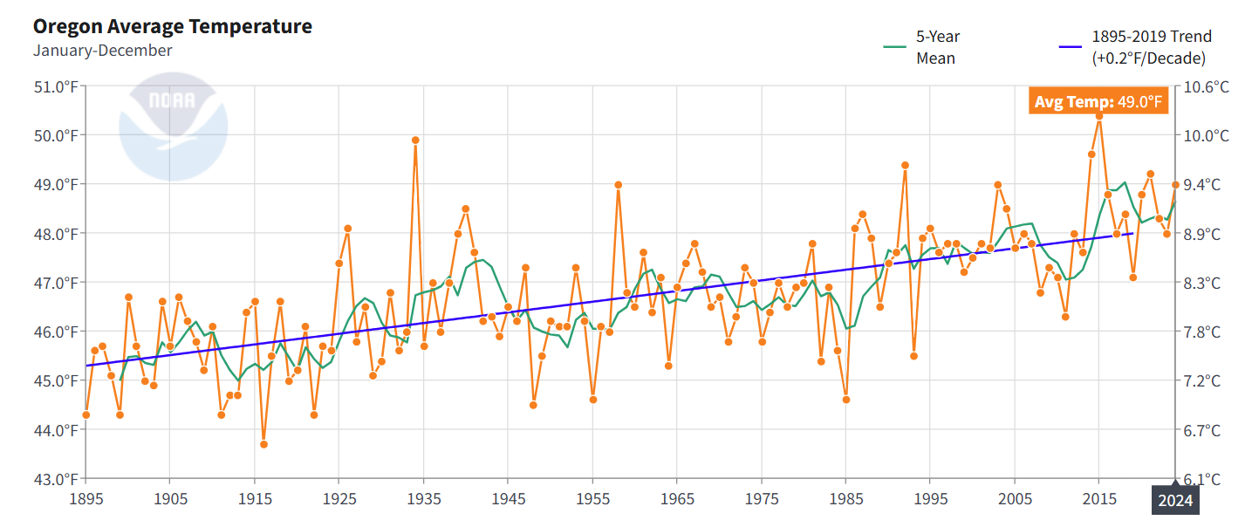
Oregon Historical Temperature Annual Average
1895 - 2024
https://www.ncei.noaa.gov/access/monitoring/climate-at-a-glance/statewide/time-series/35/tavg/12/12/1895-2024

Slide 4
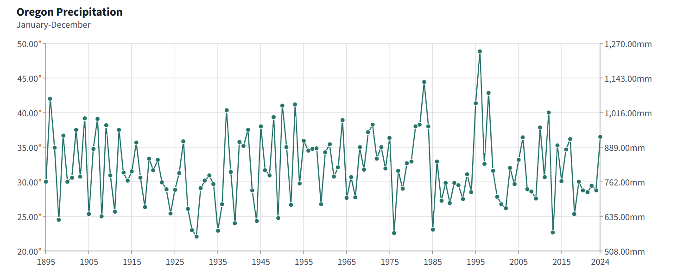
Oregon Historical Precipitation Annual Average
1895 - 2024
https://www.ncei.noaa.gov/access/monitoring/climate-at-a-glance/statewide/time-series/35/pcp/12/12/1895-2024

Slide 5
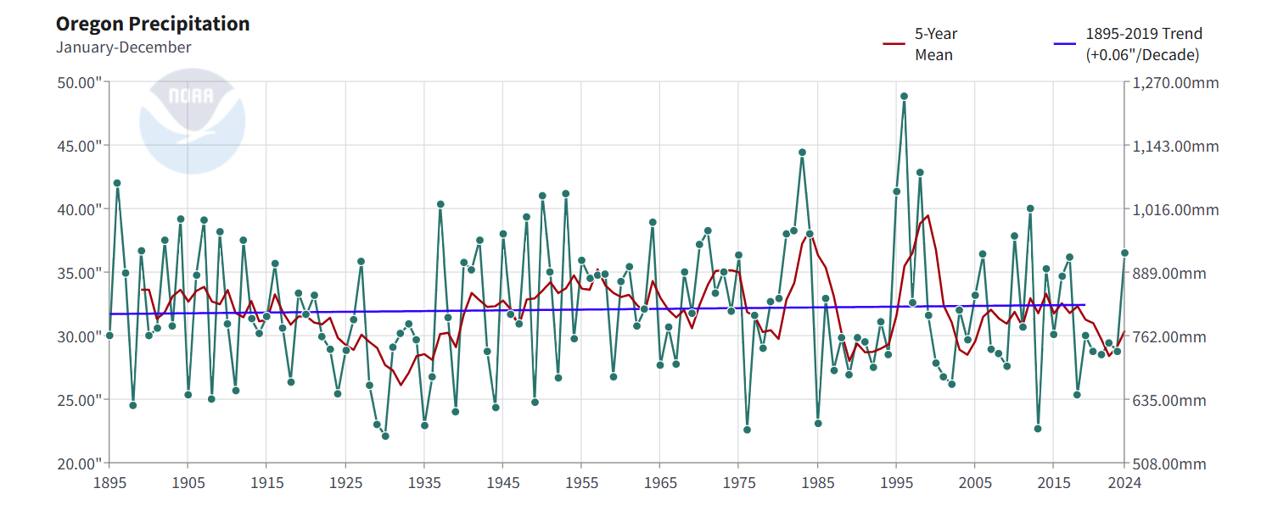
Oregon Historical Precipitation Annual Average
1895 - 2024
https://www.ncei.noaa.gov/access/monitoring/climate-at-a-glance/statewide/time-series/35/pcp/12/12/1895-2024

Slide 6
Intergovernmental Panel on Climate Change -IPCC Model Scenarios (Predictions vs Projections)
2014 AR5: Representative Concentration Pathways (RCPs)
2021 AR6: Shared Socioeconomic Pathways (SSPs)
RCP 2.6 Low level emissions (almost immediate cessation) SSP1-2.6
RCP 4.5 Ambitious reductions in emissions trajectory SSP2-4.5
RCP 6.0 Less ambitious emissions reduction trajectory SSP4-6.0
RCP 8.5 Rapid increase in emissions – SSP5-8.5
‘Worst Case Scenario’ → ‘Business as Usual’
USGS Climate Change Viewer Employs 20 models
Notes:
CHANGE 2019: I have a note to delete this one

Slide 7
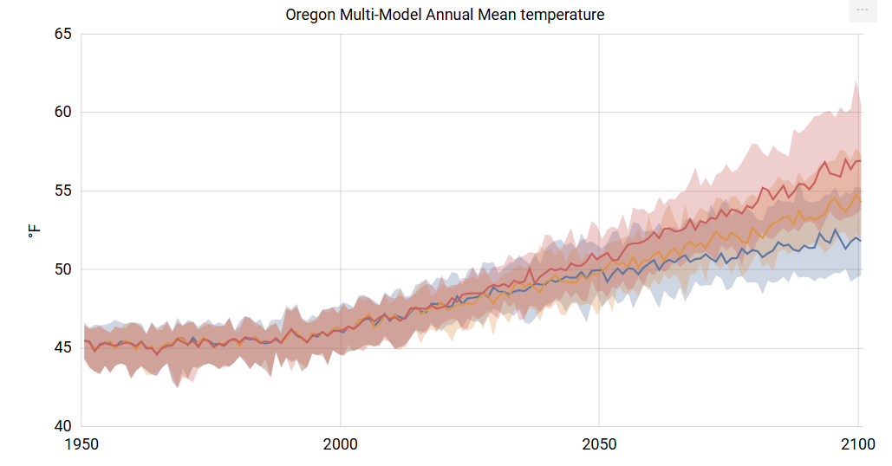
Oregon Average Temperature Projections to 2100
https://apps.usgs.gov/nccv/loca2/nccv2_loca2_counties.html

Slide 8
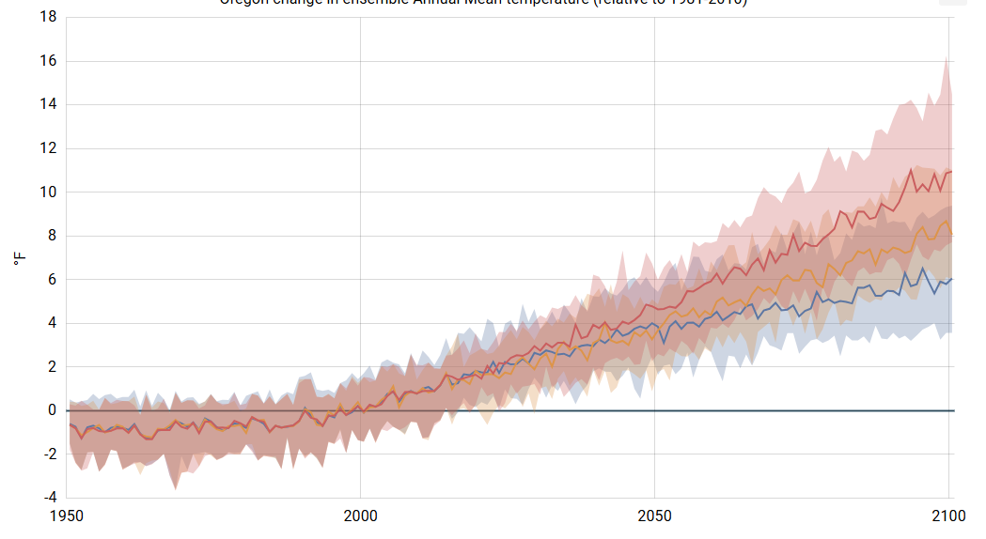
Oregon Average Temperature ∆ Projections to 2100: Baseline 1981-2010
11°F ≈ 6.1 °C
https://apps.usgs.gov/nccv/loca2/nccv2_loca2_counties.html

Slide 9
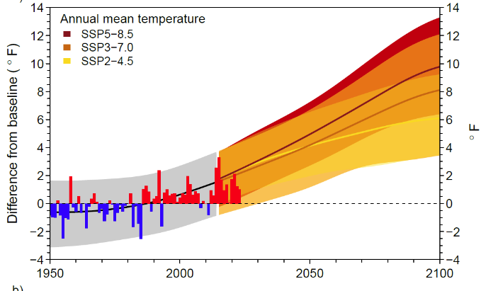
OCCRI Projections - Baseline 1950-2014 average
https://oregonstate.app.box.com/s/ziqc1kisxkup45147phjp526kheugqnb

Slide 10
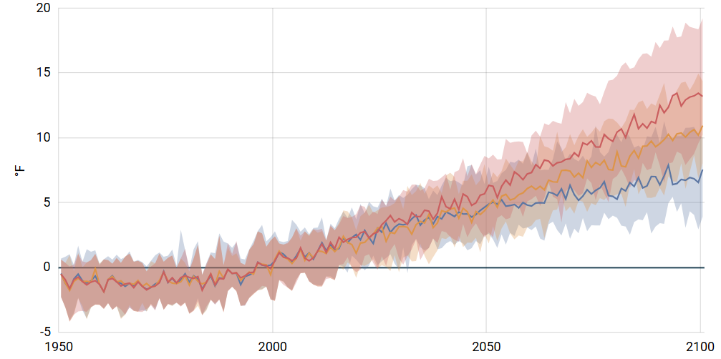
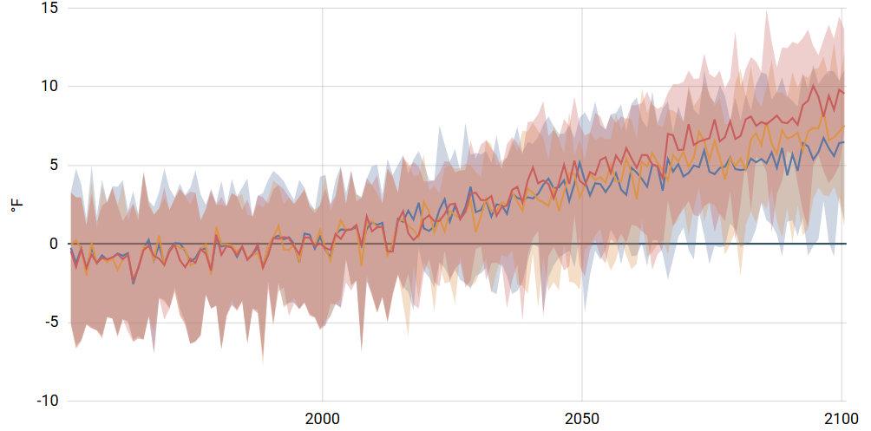
Summer vs Winter Projected ∆ in Temperature:
Baseline 1981-2010
Summer
Winter
https://apps.usgs.gov/nccv/loca2/nccv2_loca2_counties.html

Slide 11
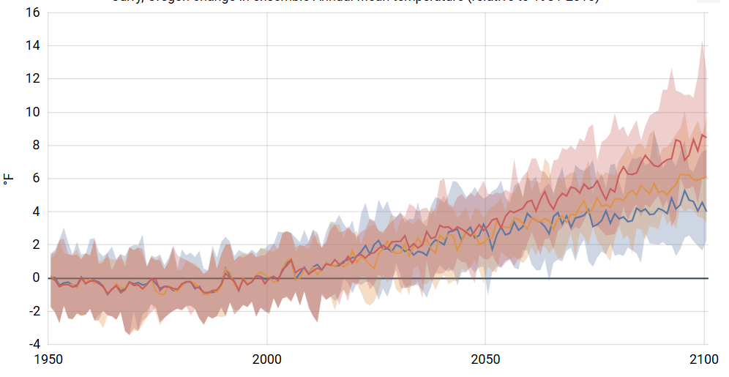
Curry Co. Average Temperature ∆ Projections to 2100: Baseline 1981-2010
https://apps.usgs.gov/nccv/loca2/nccv2_loca2_counties.html

Slide 12
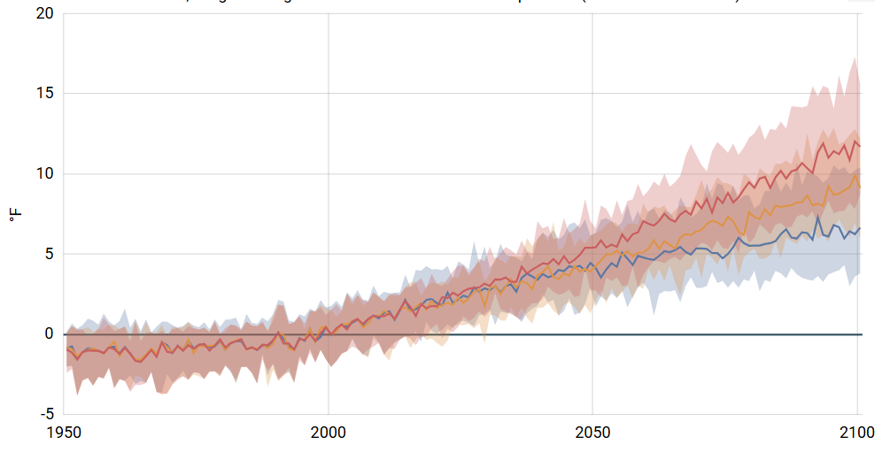
Malheur Co. Average Temperature ∆ Projections to 2100: Baseline 1981-2010
https://apps.usgs.gov/nccv/loca2/nccv2_loca2_counties.html

Slide 13
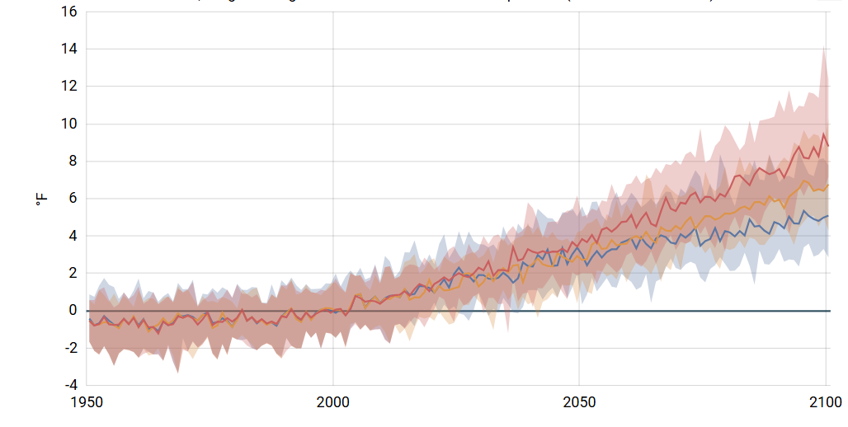
Lincoln Co. Average Temperature ∆ Projections to 2100: Baseline 1981-2010
https://apps.usgs.gov/nccv/loca2/nccv2_loca2_counties.html

Slide 14
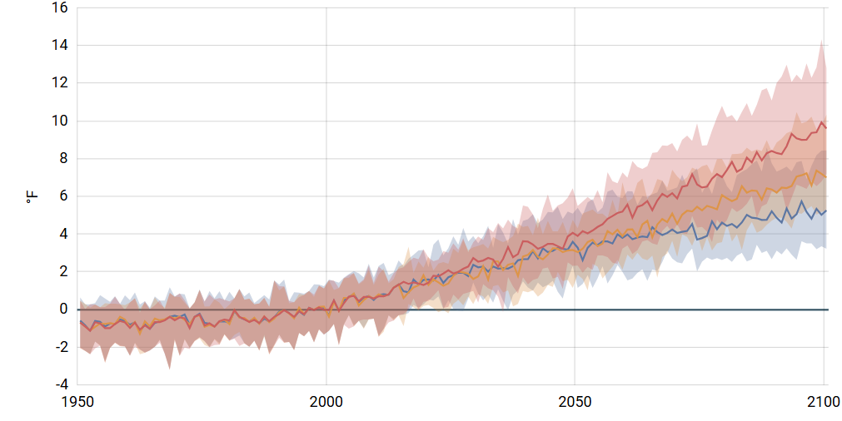
Marion Co. Average Temperature ∆ Projections to 2100: Baseline 1981-2010
https://apps.usgs.gov/nccv/loca2/nccv2_loca2_counties.html

Slide 15
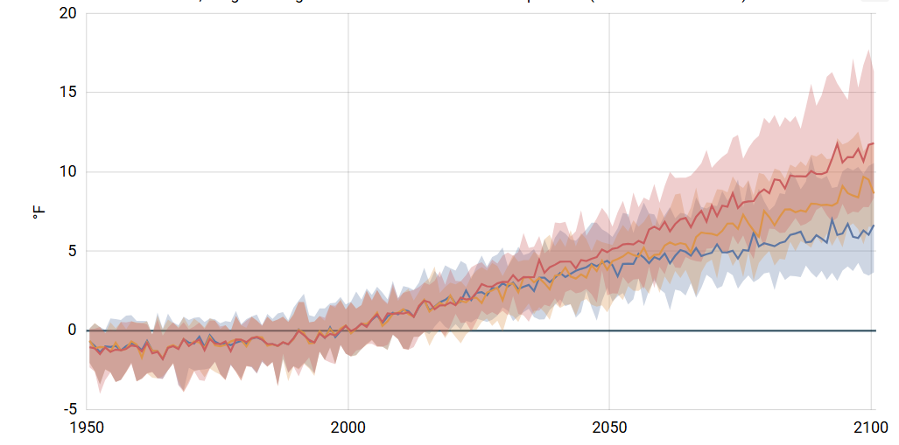
Baker Co. Average Temperature ∆ Projections to 2100: Baseline 1981-2010
https://apps.usgs.gov/nccv/loca2/nccv2_loca2_counties.html

Slide 16
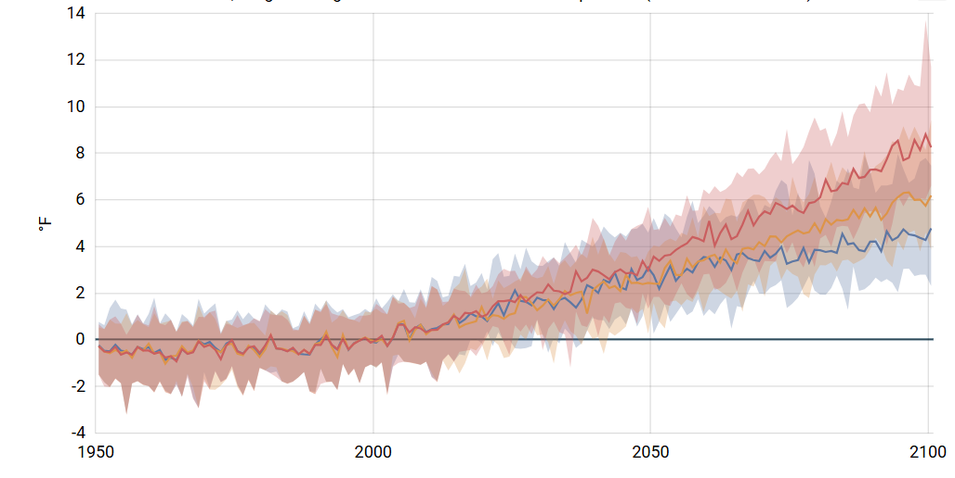
Tillamook Co. Average Temperature ∆ Projections to 2100: Baseline 1981-2010
https://apps.usgs.gov/nccv/loca2/nccv2_loca2_counties.html

Slide 17
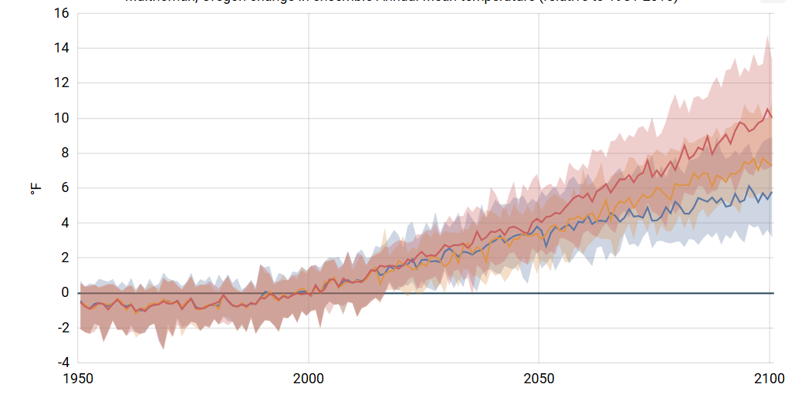
Multnomah Co. Average Temperature ∆ Projections to 2100: Baseline 1981-2010
https://apps.usgs.gov/nccv/loca2/nccv2_loca2_counties.html

Slide 18
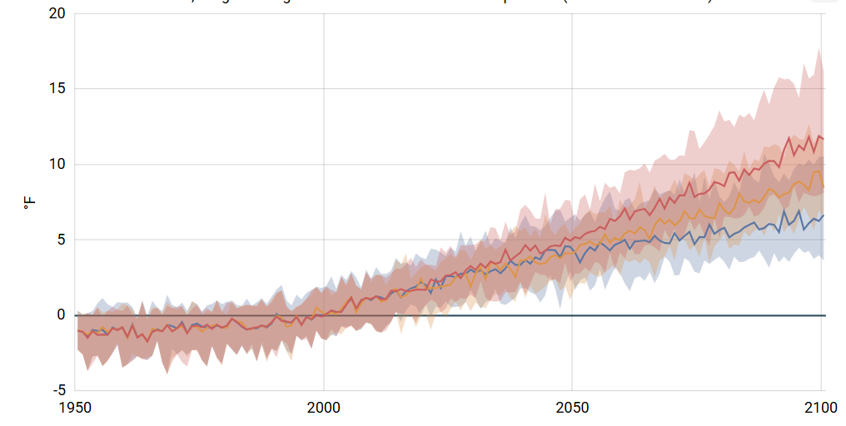
Wallowa Co. Average Temperature ∆ Projections to 2100: Baseline 1981-2010
https://apps.usgs.gov/nccv/loca2/nccv2_loca2_counties.html

Slide 19
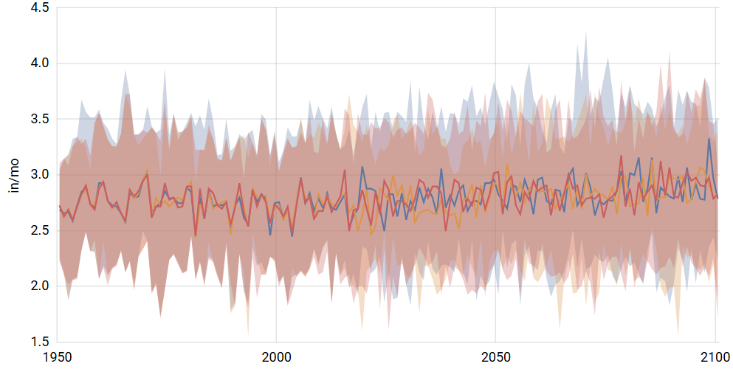
Oregon Precipitation Projections to 2075-2099
https://apps.usgs.gov/nccv/loca2/nccv2_loca2_counties.html

Slide 20
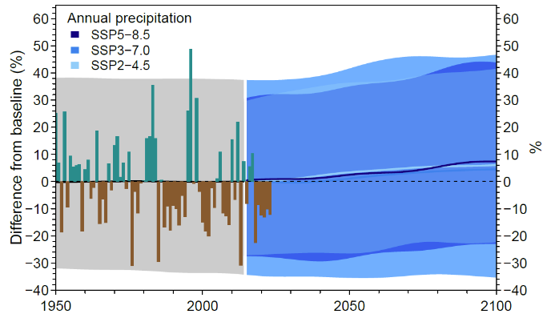
OCCRI Precipitation Projections - Baseline 1950-2014 average
https://oregonstate.app.box.com/s/ziqc1kisxkup45147phjp526kheugqnb

Slide 21
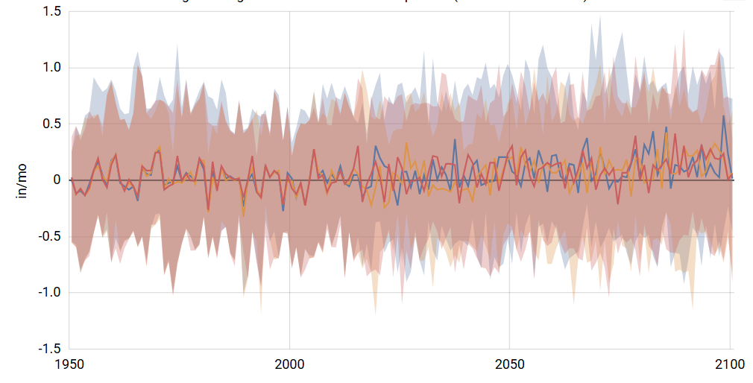
Oregon Precipitation ∆ Projections to 2075-2099
https://apps.usgs.gov/nccv/loca2/nccv2_loca2_counties.html

Slide 22
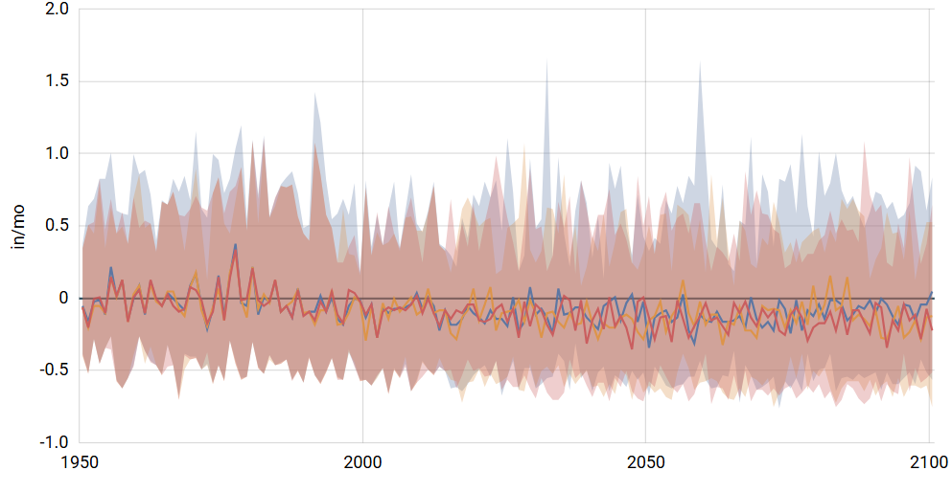
Summer Precipitation ∆ Projections to 2075-2099
https://apps.usgs.gov/nccv/loca2/nccv2_loca2_counties.html

Slide 23
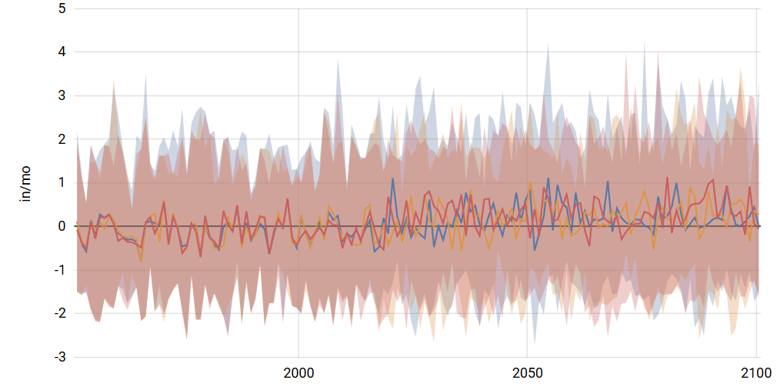
Winter Precipitation ∆ Projections to 2075-2099
https://apps.usgs.gov/nccv/loca2/nccv2_loca2_counties.html

Slide 24
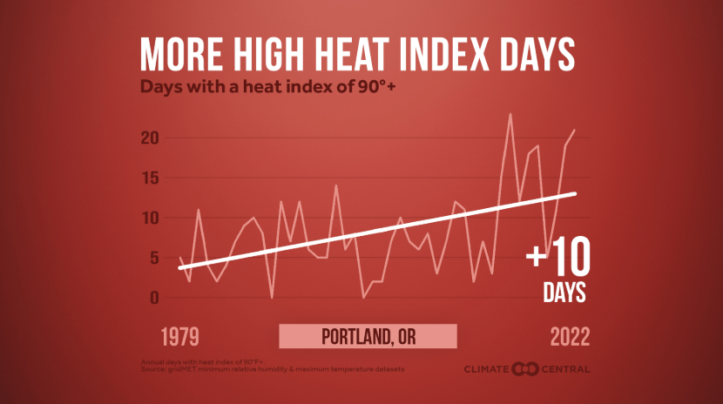
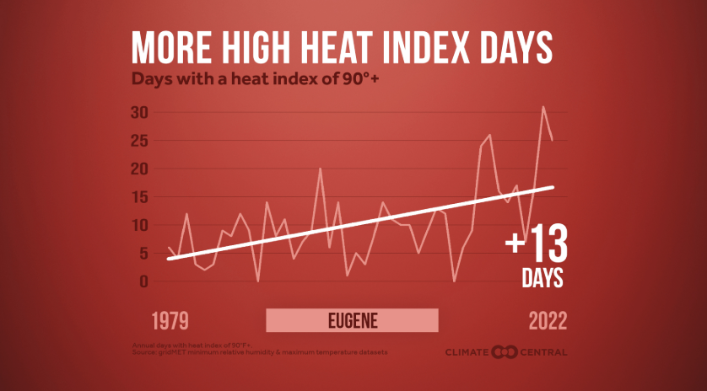
Trend in extremely hot days

Slide 25
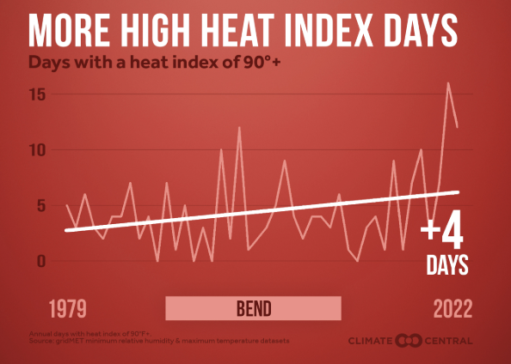
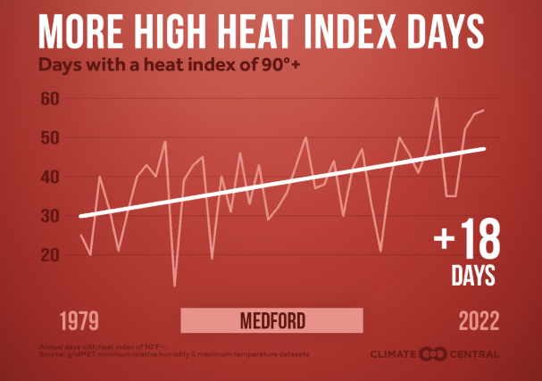
Trend in extremely hot days

Slide 26

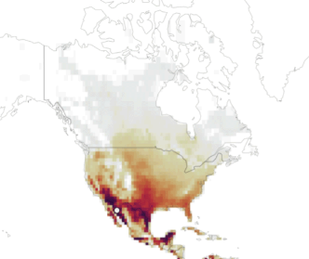
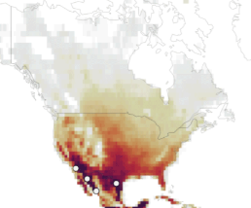
Days in U.S. over 95°F
1994-2014
1.5°C
https://www.wri.org/insights/future-extreme-heat-cities-data

Slide 27
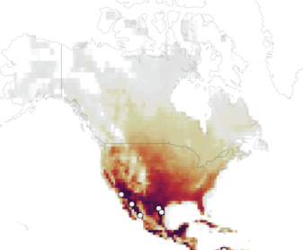
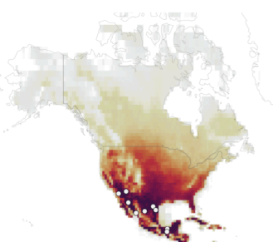
Days in U.S. over 95°F
2.0°C
3.0°C
https://www.wri.org/insights/future-extreme-heat-cities-data

Slide 28
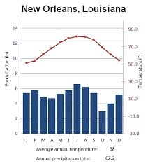
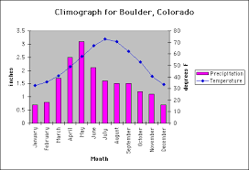
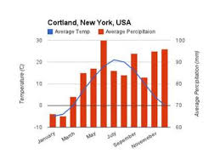
Jackson County 20th Century Monthly Averages
The
Mediterranean Climate
European Mediterranean
SW and S. Australia
S. Africa western Cape
Western S.A.
Western N.A.
Historically, during late summer
soil and vegetation dry out →
Fire risk increases
Dry forest fires frequent
(every < 10 years)
Surviving vegetation is fire-prone,
fire adapted & fire dependent.
https://www.ncdc.noaa.gov/cag/county/time-series/OR-029/tavg/1/12/1895-2019?base_prd=true&firstbaseyear=1901&lastbaseyear=2000

Slide 29
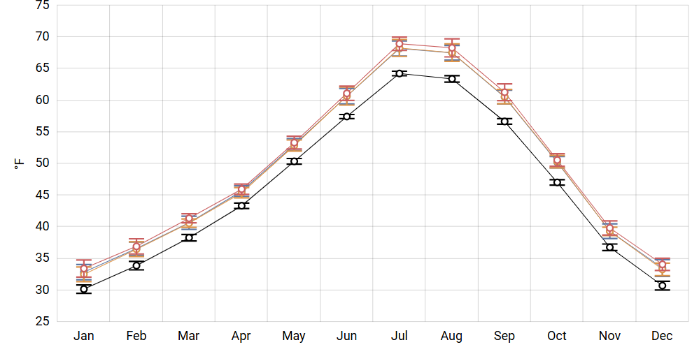
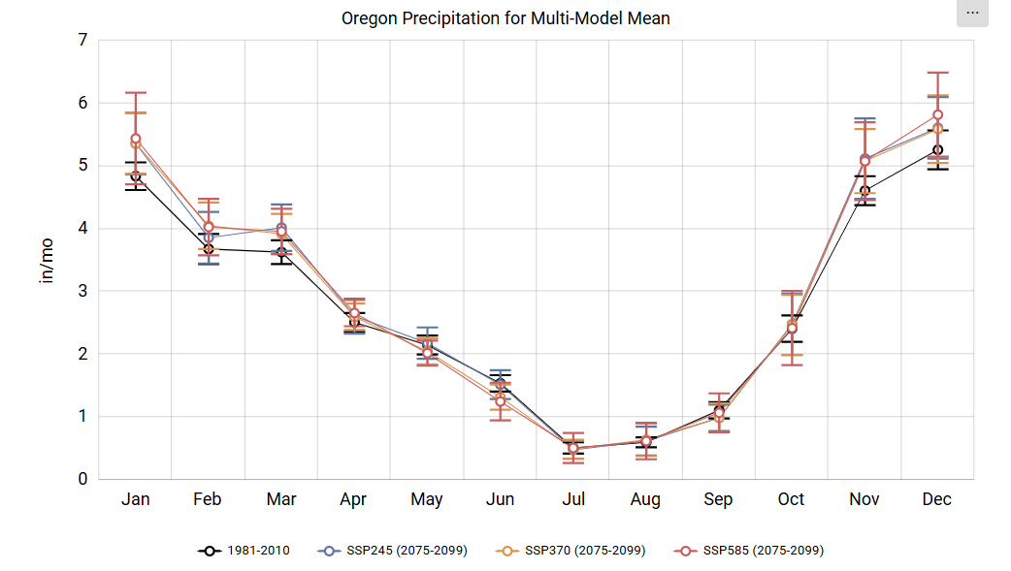
Oregon Mean Temperature Climograph: 2025-2049

Slide 30
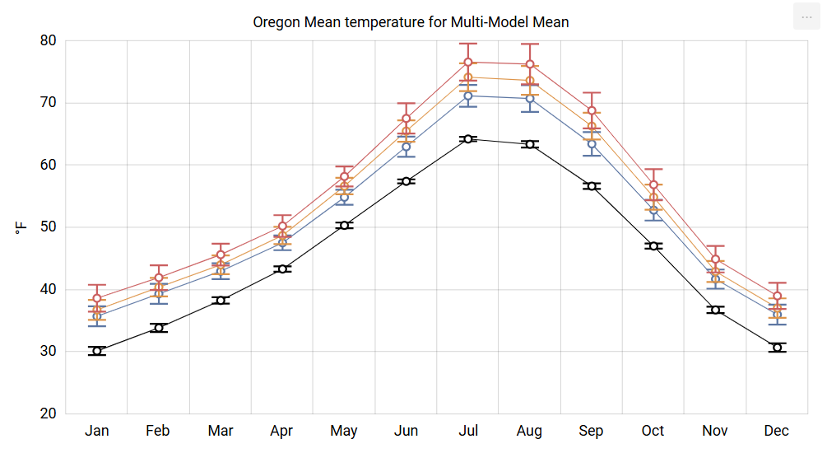
Oregon Mean Temperature Climograph to 2075-2099
Range in warming –
12°F ≈ 6.5 °C
8°F ≈ 4.5 °C

Slide 31
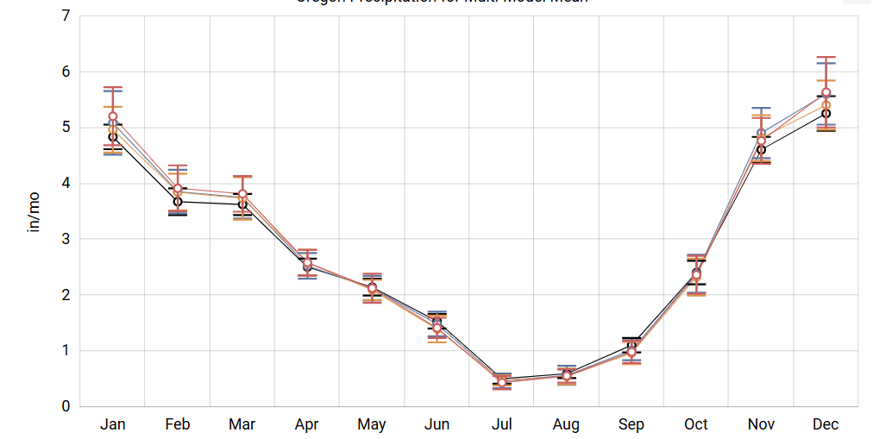
Oregon Mean Precipitation Climograph: 2025-2049

Slide 32
Oregon Mean Precipitation Climograph to 2075-2099
increase
increase
Decrease

Slide 33
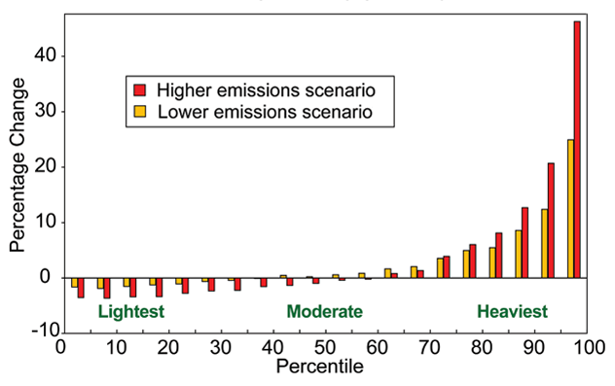
Projected Patterns in Light, Moderate & Heavy Precipitation Events by 2090s
Increased
Heavy
Downpour
Days
Reduced
Light
Drizzle
Days
Global Climate Change Impacts in the U.S. 2009 p. 32
https://downloads.globalchange.gov/usimpacts/pdfs/climate-impacts-report.pdf

Slide 34
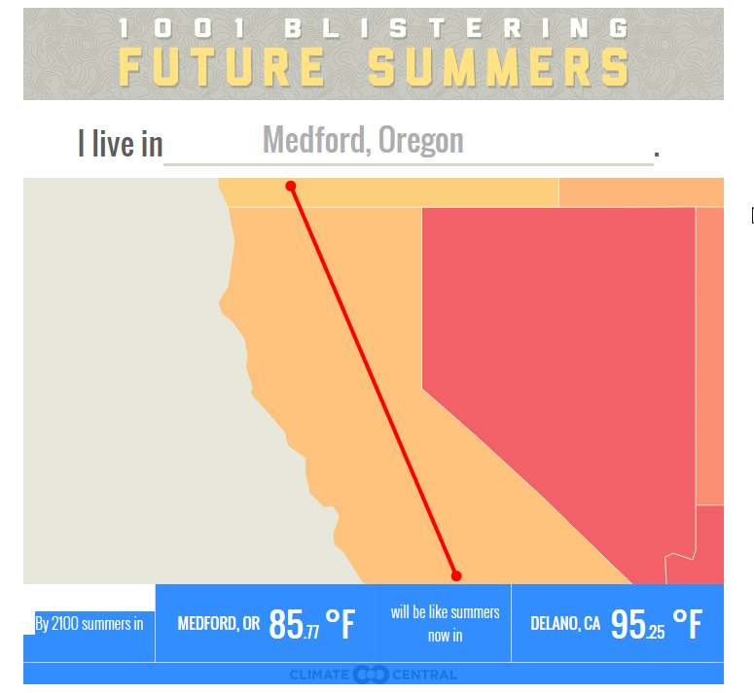

Where In The World…? By 2050, 2100
http://www.climatecentral.org/news/summer-temperatures-co2-emissions-1001-cities-16583
Notes:
0 – Residents of Medford now experience the summer climate of Medford.
1 – By 2050, it will be like the current climate of Redding,
2 – By 2100 it will be like the current climate of Delano, CA
3 – Which is near Bakersfield

Slide 35
Where In The World…? By 2050
Mid-Century = Redding
http://www.climatecentral.org/news/summer-temperatures-co2-emissions-1001-cities-16583

Slide 36
Where In The World…? By 2100
Near Bakersfield
Late-Century = Delano
http://www.climatecentral.org/news/summer-temperatures-co2-emissions-1001-cities-16583

Slide 37
Oregon Climate Trends and Projections
QUESTIONS
QUESTIONS
Alan Journet
Cofacilitator, Southern Oregon Climate Action Now
alan@socan.eco; 541-301-4107

