Slide 1
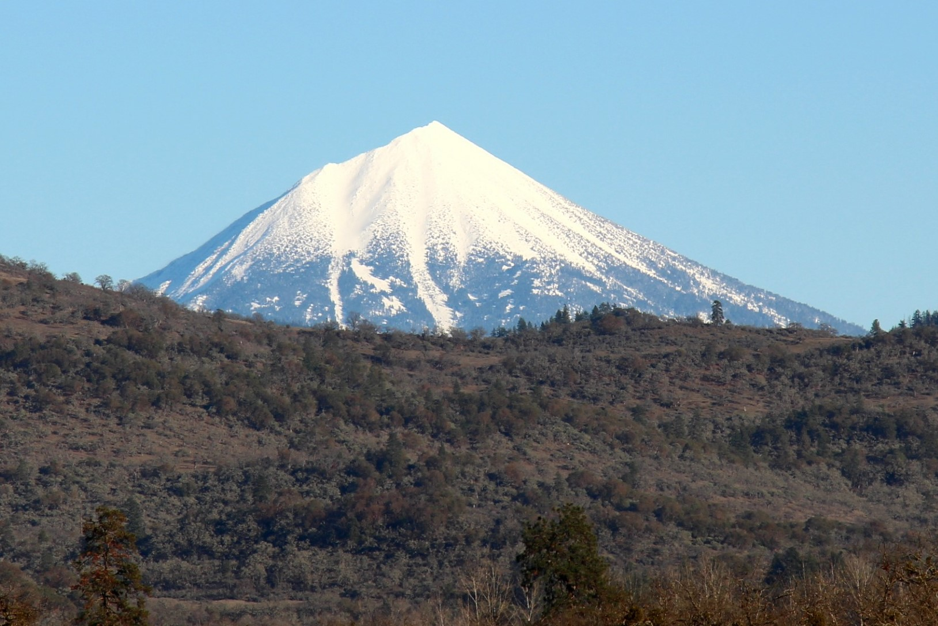
Oregon Climate Change- Future Implications
Alan Journet
Cofacilitator, Southern Oregon Climate Action Now
alan@socan.eco; 541-301-4107

Slide 2
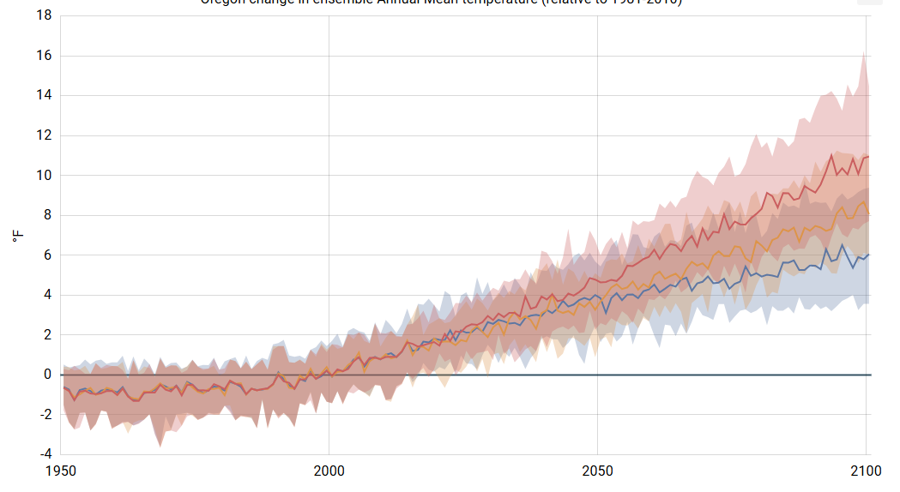
Oregon Average Temperature ∆ Projections to 2100: Baseline 1981-2010
Reminder
11°F ≈ 6.1 °C
https://apps.usgs.gov/nccv/loca2/nccv2_loca2_counties.html

Slide 3
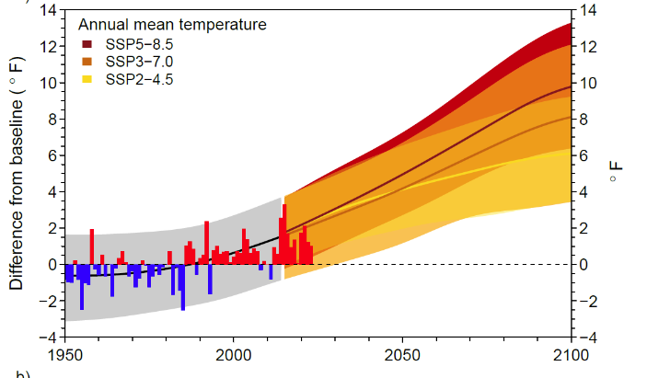
OCCRI Projections - Baseline 1950-2014 average
https://oregonstate.app.box.com/s/ziqc1kisxkup45147phjp526kheugqnb

Slide 4
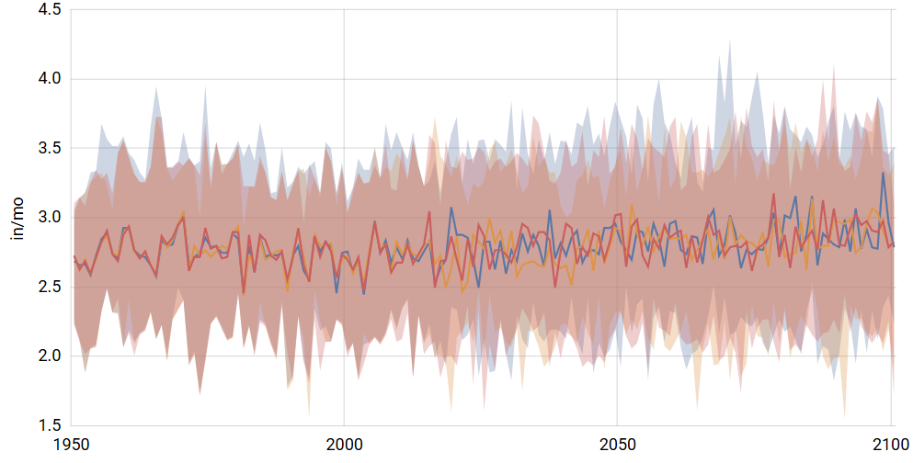
Oregon Precipitation Projections to 2075-2099
https://apps.usgs.gov/nccv/loca2/nccv2_loca2_counties.html

Slide 5
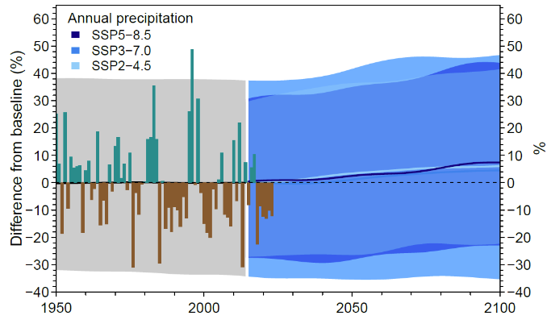
OCCRI Precipitation Projections - Baseline 1950-2014 average
https://oregonstate.app.box.com/s/ziqc1kisxkup45147phjp526kheugqnb

Slide 6
Physiological Tolerance
Health, Growth, Reproductive Activity
Response of Organism
Range for a Critical Environmental Condition
Temperature, Salinity, Soil Moisture

Slide 7
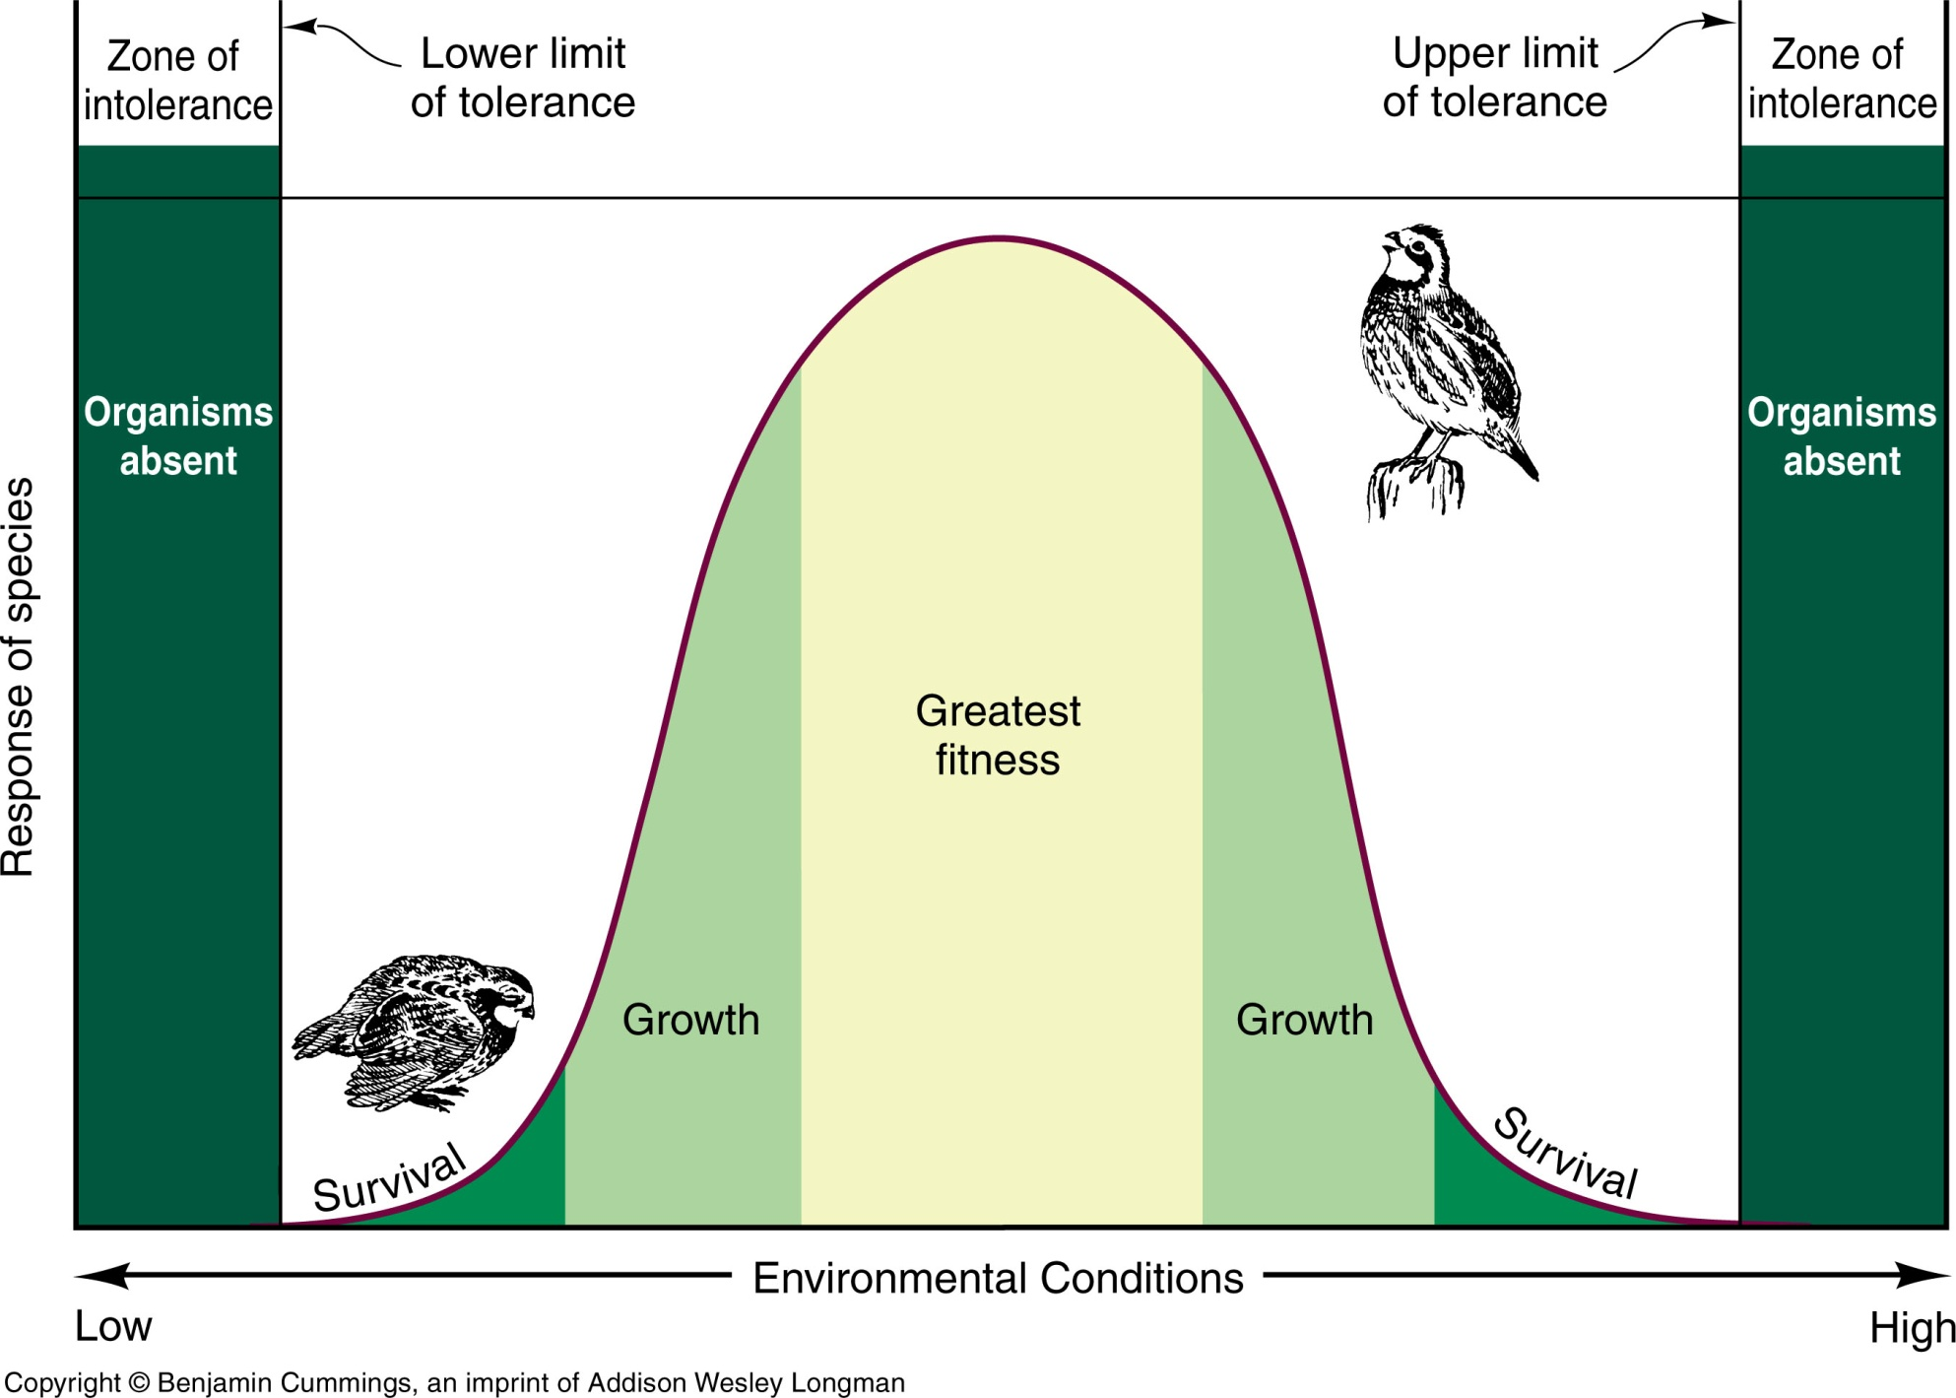
Physiological Tolerance
Optimum
Physiological performance, Growth / Development rate
Health, Growth, Reproductive Activity
Response of Organism
Population Density
Range for a Critical Environmental Condition
Temperature, Salinity, Soil Moisture

Slide 8
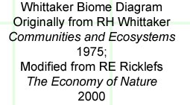
What Determines Biome Location? Whittaker’s Biome Chart
Average Temperature
Average Precipitation
Arctic / Alpine
-15
Conditions
Don’t
Exist
-10
Cold Temperate
-05
Local Historic 1901 – 2000:
00
Mean Annual Temperature ⁰C
Precipitation = 21.1 inches; 53.5cm
5
Temperature = 52.7⁰F = 11.5⁰C
10
Warm Temperate
X
Modified from
15
20
Tropical
25
30
0
50
100
150
200
250
300
350
400
450
Precipitation cm

Slide 9
What Determines Biome Location? Whittaker’s Biome Chart
-15
Arctic / Alpine
-10
-05
Cold Temperate
00
5
Mean Annual Temperature ⁰C
10
Woodland Shrubland
Grassland
X
Warm Temperate
15
20
Tropical
25
30
0
50
100
150
200
250
300
350
400
450
Precipitation cm

Slide 10
What Determines Biome Location? Whittaker’s Biome Chart
Advancing edge
-15
Arctic / Alpine
Tundra
-10
Boreal coniferous forest
-05
Cold Temperate
00
Cold desert
Temperate deciduous forest
Temperate rainforest
5
Mean Annual Temperature ⁰C
10
Woodland Shrubland
Grassland
Tropical mountain forest
X
Temperate coniferous forest
Warm Temperate
15
20
Evergreen tropical
seasonal forest
Savanna
Tropical dry forest
Tropical
Hot desert
Tropical Rainforest
25
Thorn woodland
Receding edge
30
0
50
100
150
200
250
300
350
400
450
Precipitation cm

Slide 11
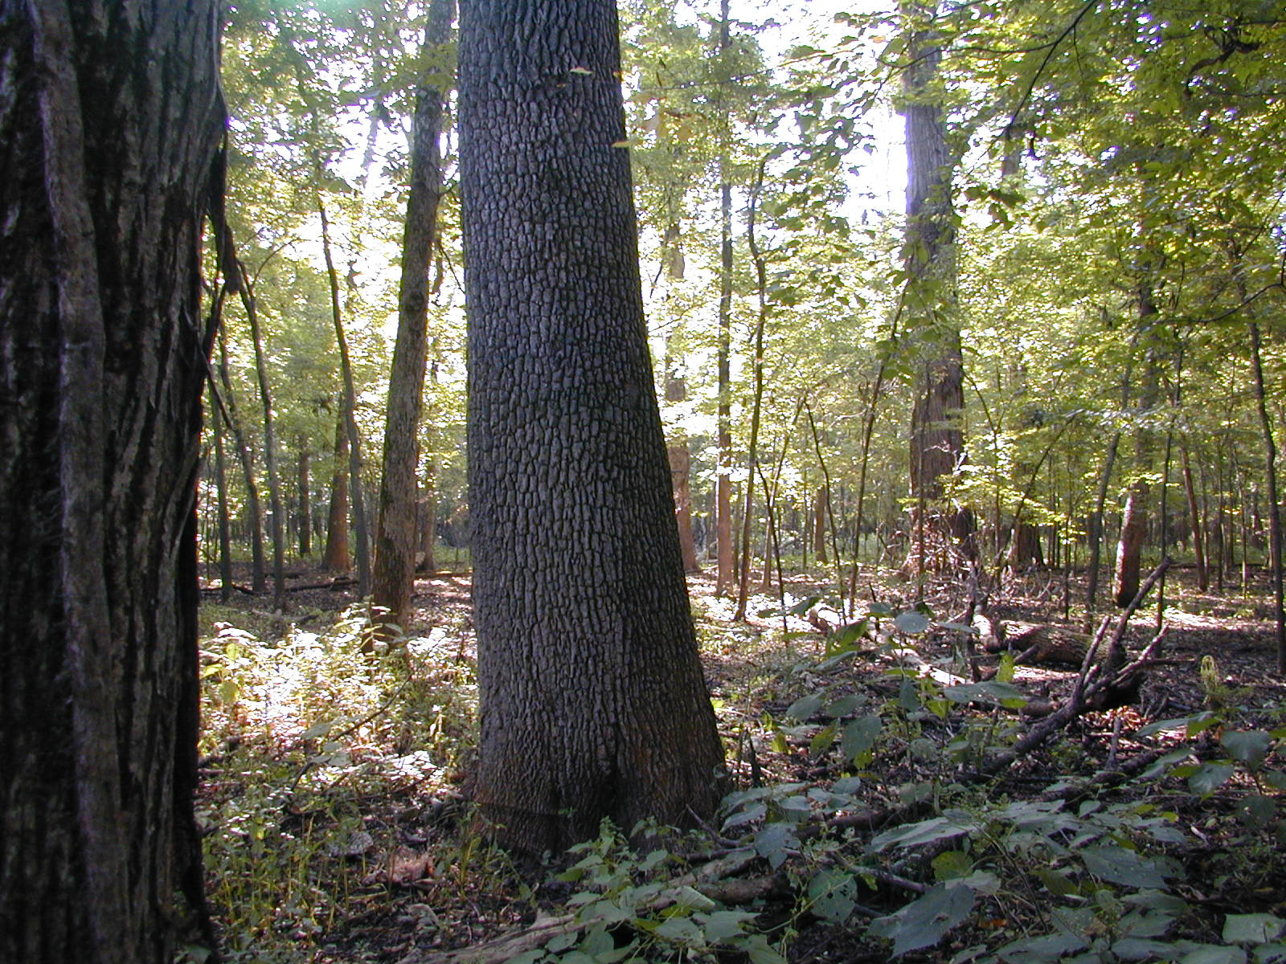
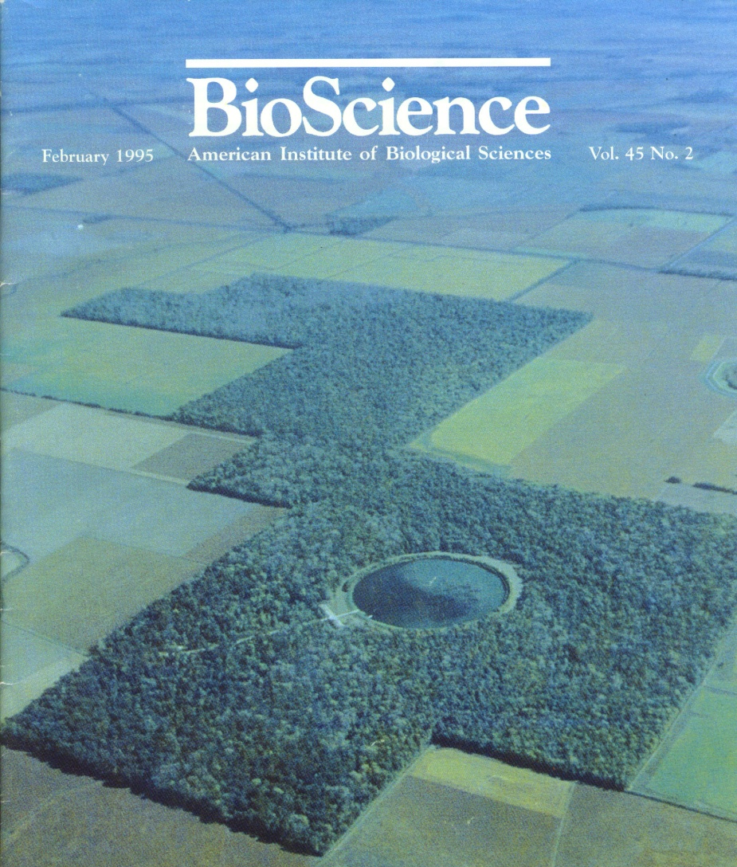
Can
biomes easily adjust
range?
Big Oak Tree State Park
SE Missouri
Imagine a pine tree
Ken McCarty: MNRC 2009
Notes:
As one wanders big Oak Tree State Park, it’s easy to imagine being lost in another time and world, when an ecological wholeness connected the biota with climate in dynamic swirls across the continent. HOW CAN THAT MIGRATION POSSIBLY HAPPEN NOW?

Slide 12
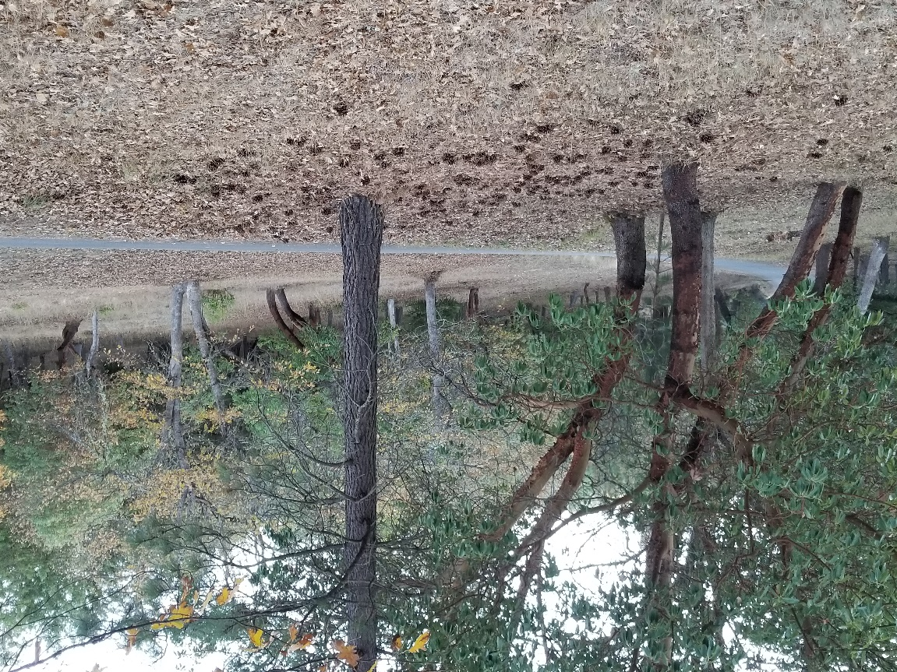
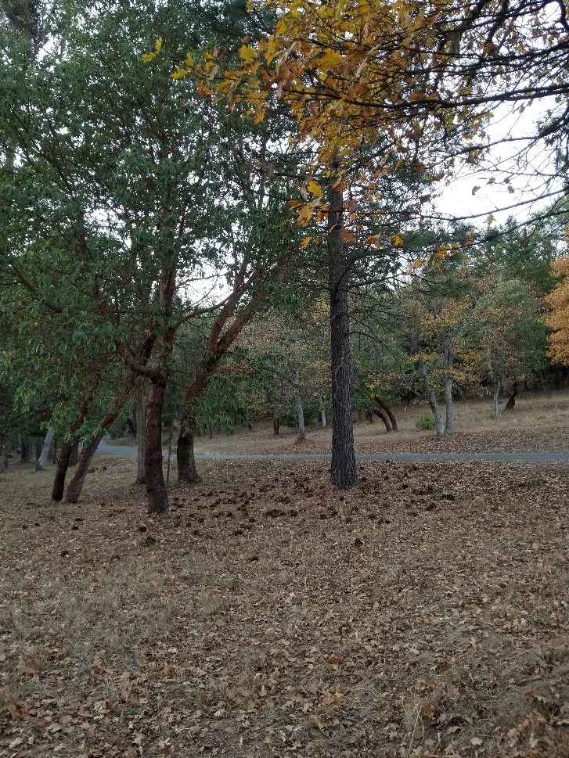
Barriers to Range Adjustment – 1 Dispersal range

Slide 13
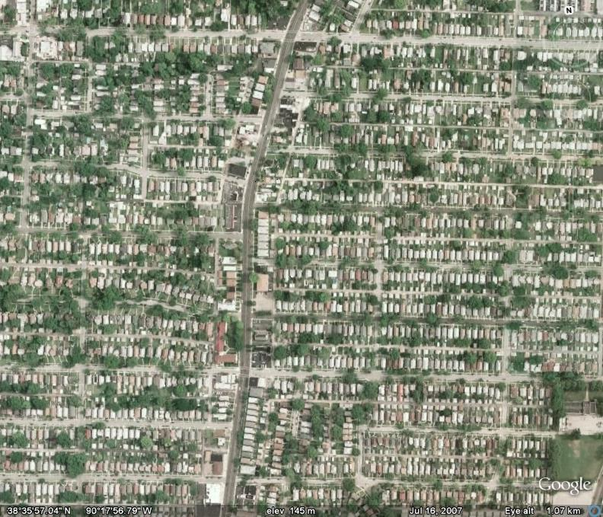
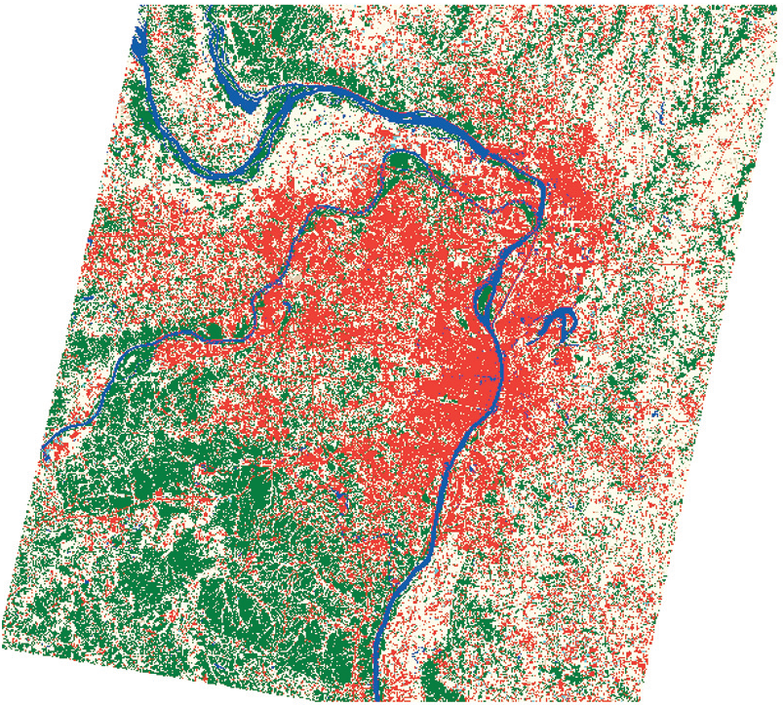
Urban Change in St. Louis
Missouri Resource Assessment Partnership
Paul Nelson: MNRC 2009
1972

Slide 14
Urban Change in St. Louis
Missouri Resource Assessment Partnership
Paul Nelson: MNRC 2009
1999

Slide 15
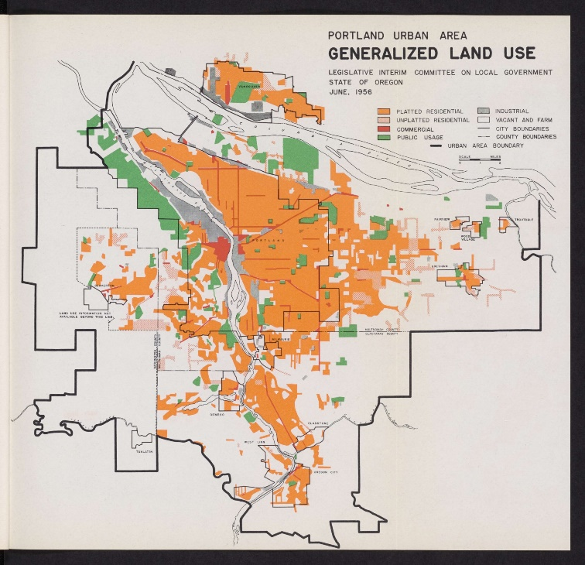
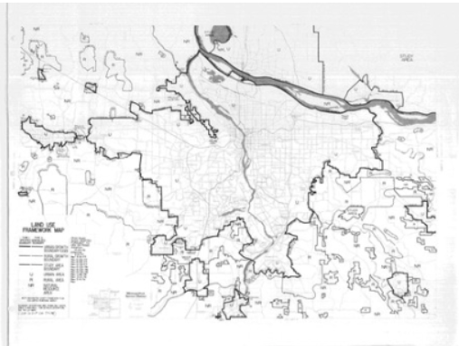
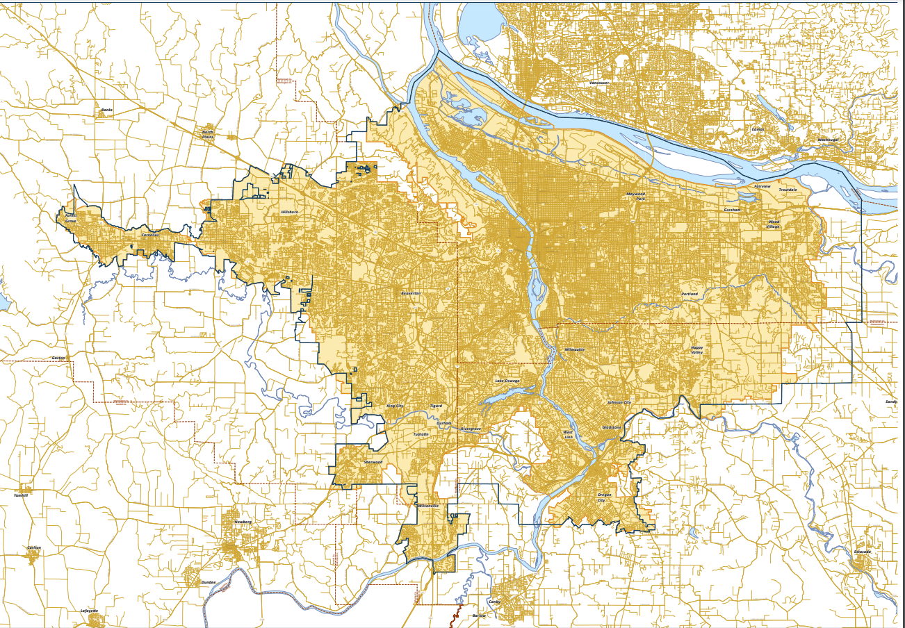
Metro Portland 1956 - 2023
1956
1979
2023
https://gallery.multcolib.org/image/portland-urban-area-generalized-land-use
https://www.oregonmetro.gov/urban-growth-boundary
https://pdxscholar.library.pdx.edu/oscdl_ugb/93/

Slide 16
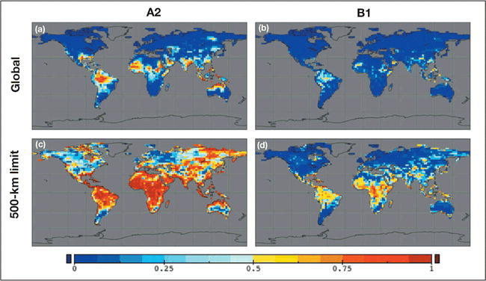
POTENTIAL GLOBAL FUTURE (TO 2100) OF CURRENT NATURAL COMMUNITIES
A2: Business as usual CO₂ → 850ppm
B1: Some redress: CO₂ → 550ppm
Probability of appropriate climate existing: Red = 0; Blue = 1
Within 500 km = 310 miles of current locations
≈ 5°C / 9°F
≈ 3.5°C / 6.3°F
1
0.75
0.5
0.25
0
Williams & Jackson 2007: https://esajournals.onlinelibrary.wiley.com/doi/10.1890/070037

Slide 17
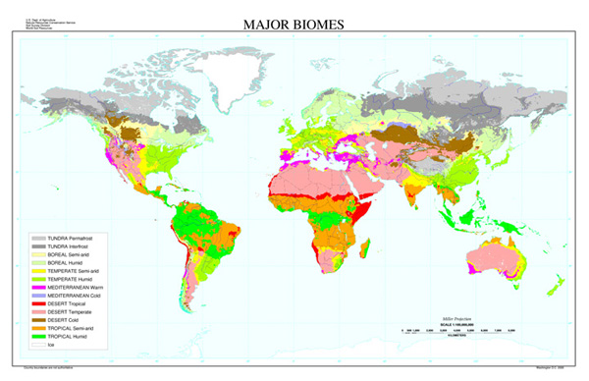
So what, you might ask?
Natural Ecosystems /Biomes of the world
Not only do these represent where our flora and fauna live…but
These control the agricultural and forestry potential of our land
http://passel.unl.edu/pages/informationmodule.php?idinformationmodule=1130447033&topicorder=6&maxto=7

Slide 18
Future of Agriculture

Slide 19
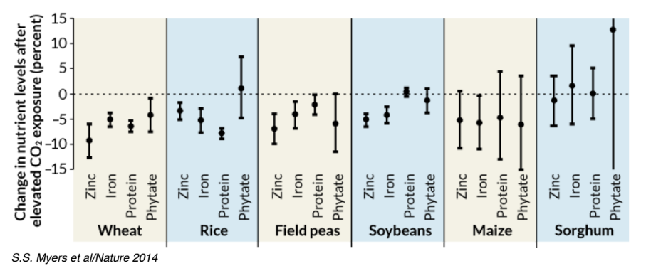
CO₂ and Human Nutrition: at ≈ 550 ppm
Phytate sabotages our ability to uptake Zn
Milius, Science News, March 13 2017 https://www.sciencenews.org/article/changing-climate-could-worsen-foods-nutrition?mode=magazine&context=361

Slide 20
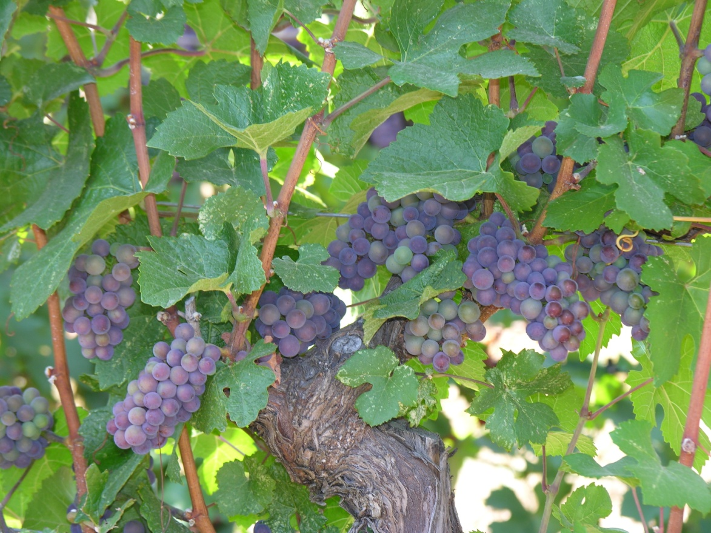
E.G., Grape varietals
A Local
Example

Slide 21
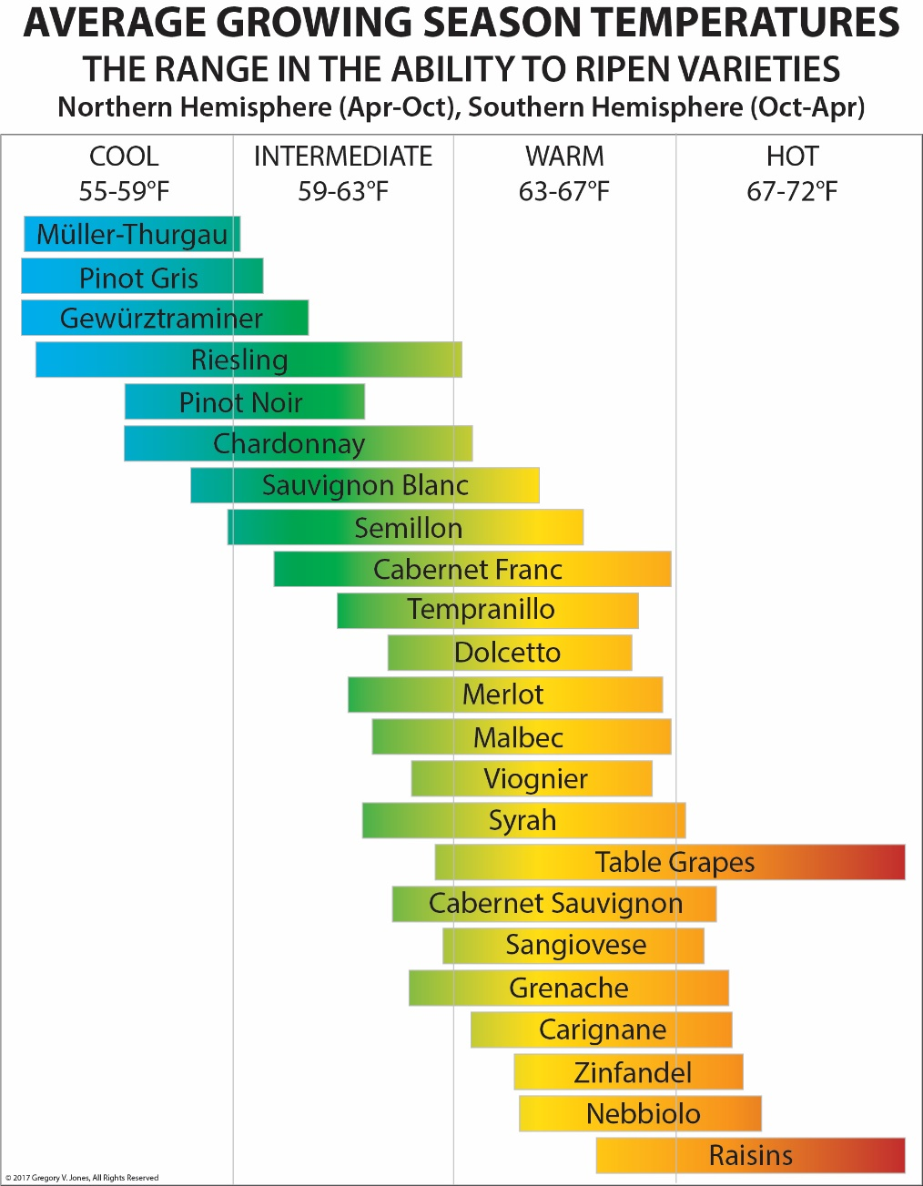
E.G., Grape varietals
https://www.guildsomm.com/public_content/features/articles/b/gregory_jones/posts/climate-grapes-and-wine

Slide 22
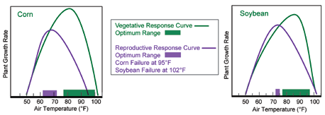
Temperature and Crop Production
Increased CO₂ may be positive, but increased temp is negative.
https://www.climatehubs.usda.gov/hubs/northeast/topic/warmer-isnt-always-better-how-rising-temperatures-impact-crop-production

Slide 23
Crop Loss with Temperature
3.13°C
1°C → 1.07% loss
Rice
1°C → 7.14% loss
2.38°C
Each ppm CO2 increase → 0.06% gain
1°C → 4.03% loss
1°C → 6.1% loss
Maize / Corn
Wheat
1°C → 8.2% loss
Each ppm CO2 increase → 0.016% loss
https://www.nature.com/articles/s41598-025-07405-8

Slide 24
Future of Our Forests

Slide 25
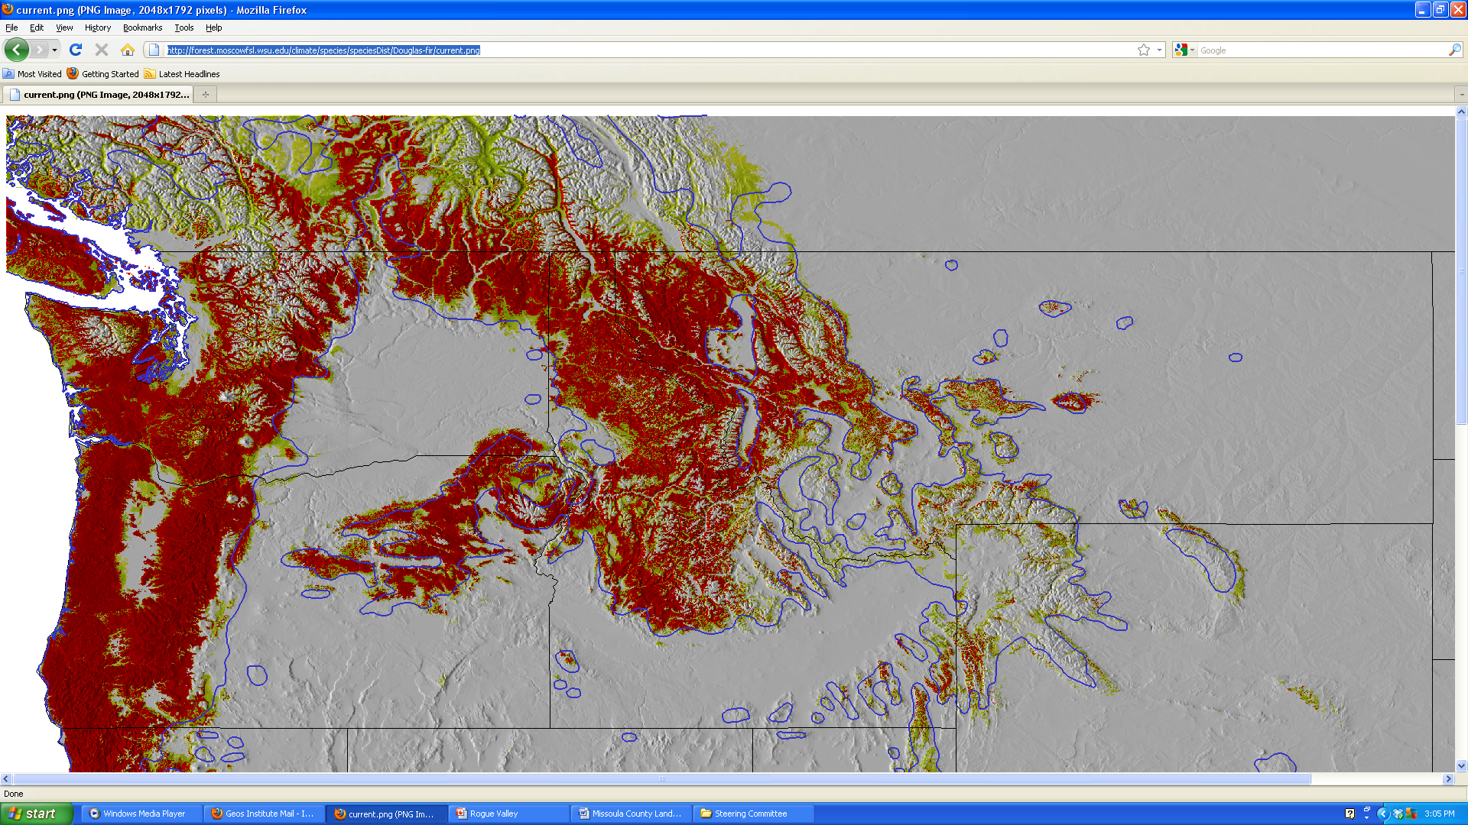
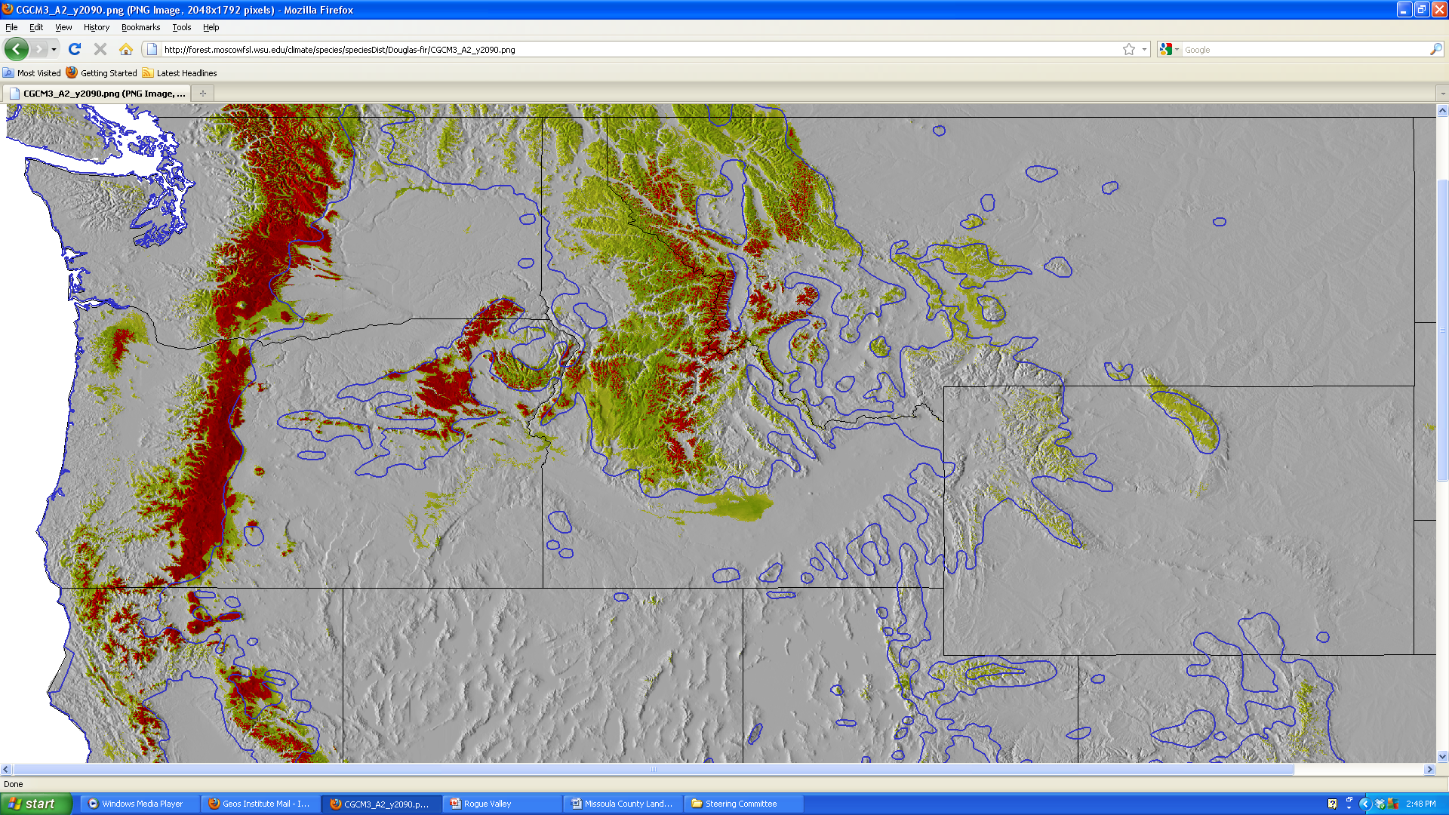
Douglas fir Now
High viability
Low viability
Absent
Douglas fir climate late century
http://charcoal.cnre.vt.edu/climate/species/

Slide 26
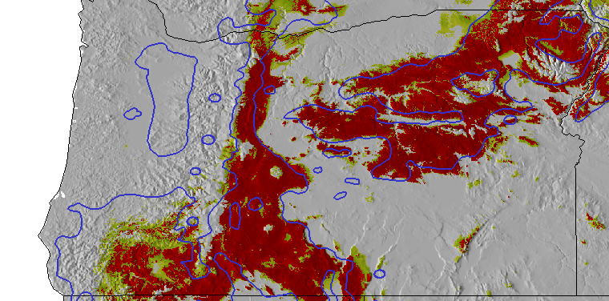
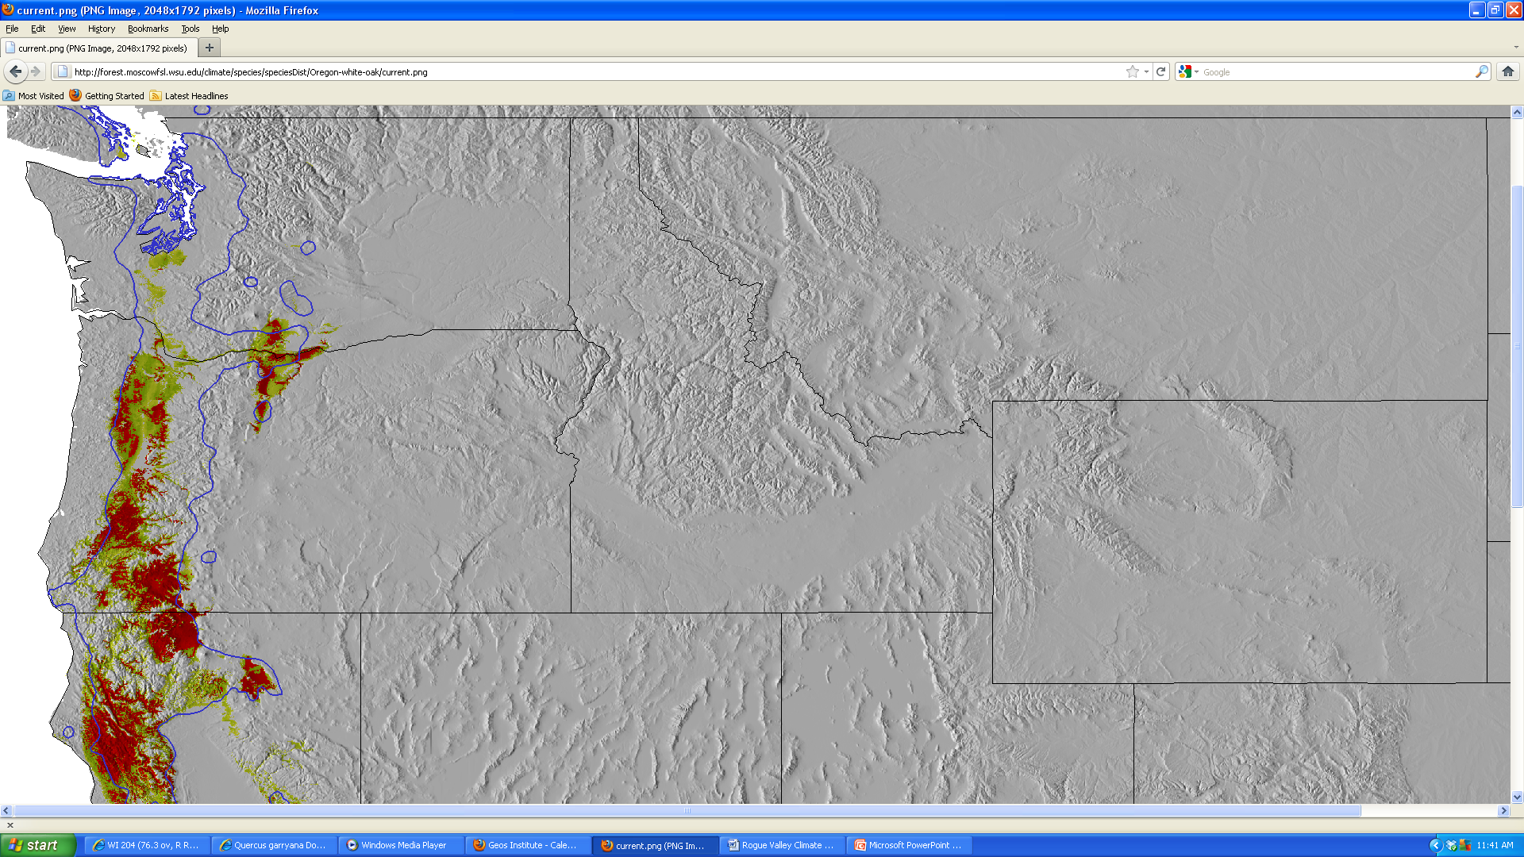
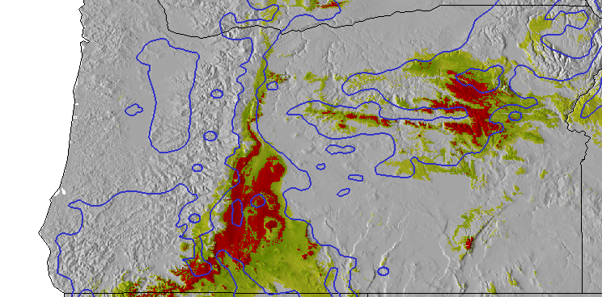
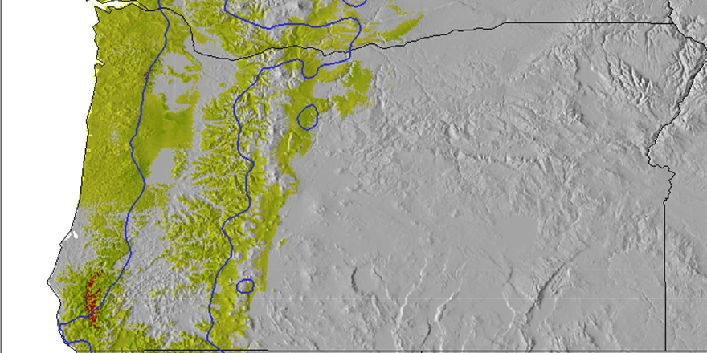
Ponderosa pine now
Garry oak now
Ponderosa pine climate late century
Garry oak climate late century
http://charcoal.cnre.vt.edu/climate/species/

Slide 27
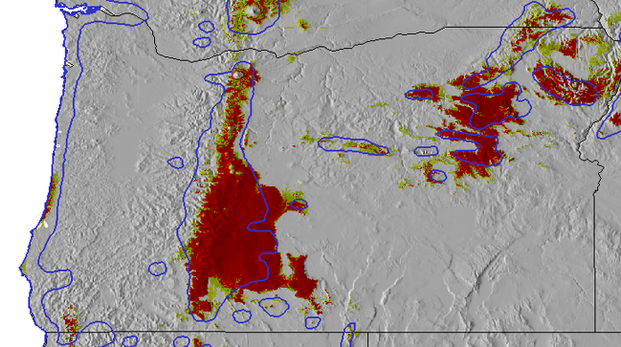
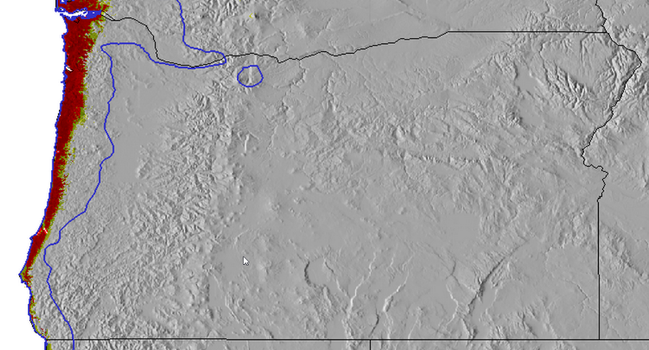
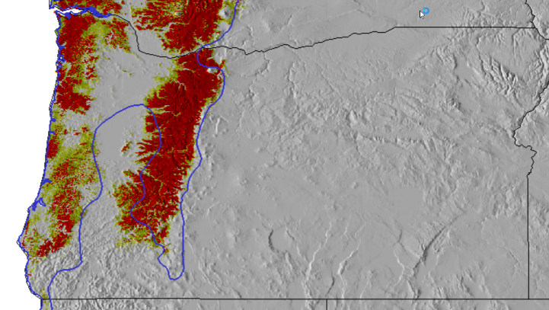
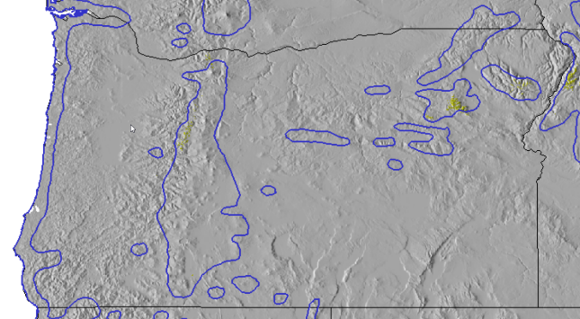
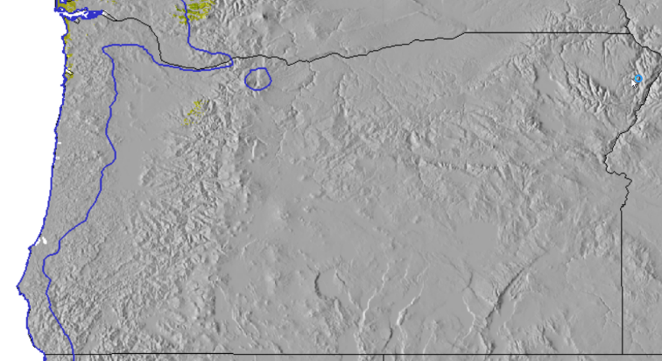
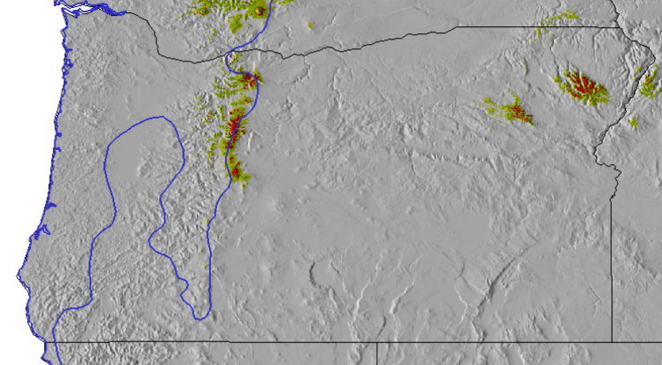
Lodgepole pine now
Sitka spruce now
Western hemlock now
Lodgepole pine climate late century
Sitka spruce climate late century
Western hemlock
climate late century
http://charcoal.cnre.vt.edu/climate/species/

Slide 28
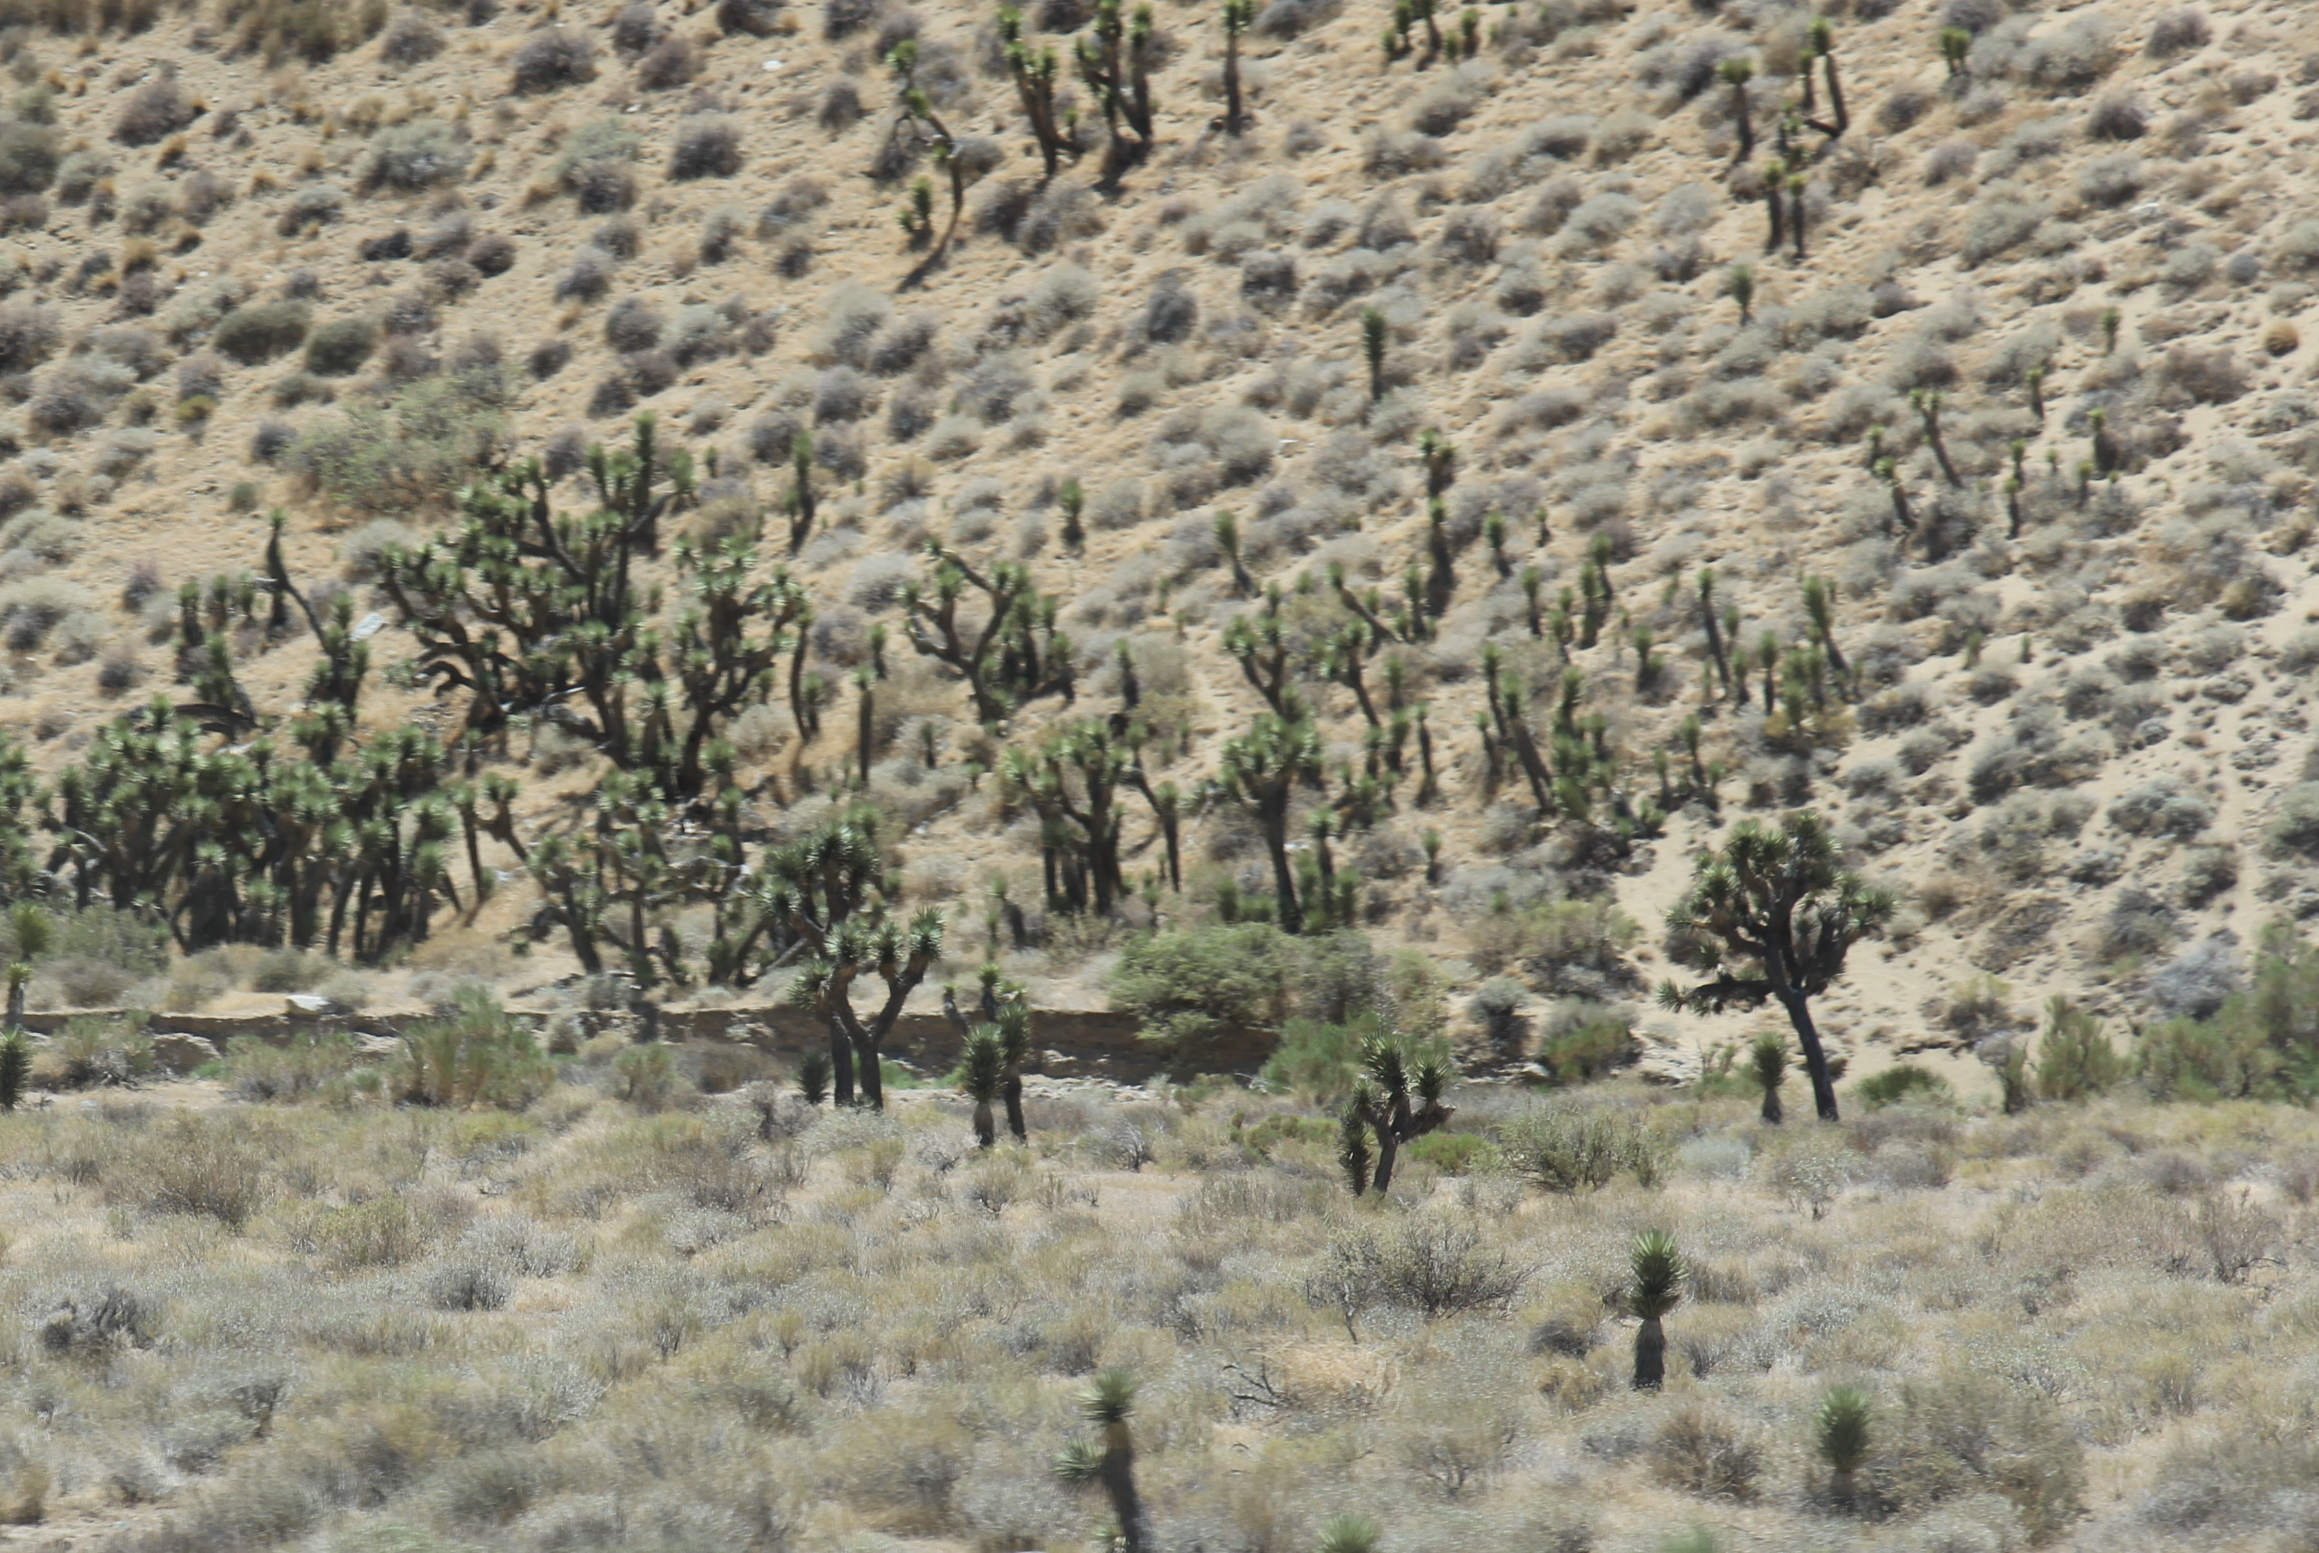
The Future of Our Forests?

Slide 29
Wildfires?

Slide 30
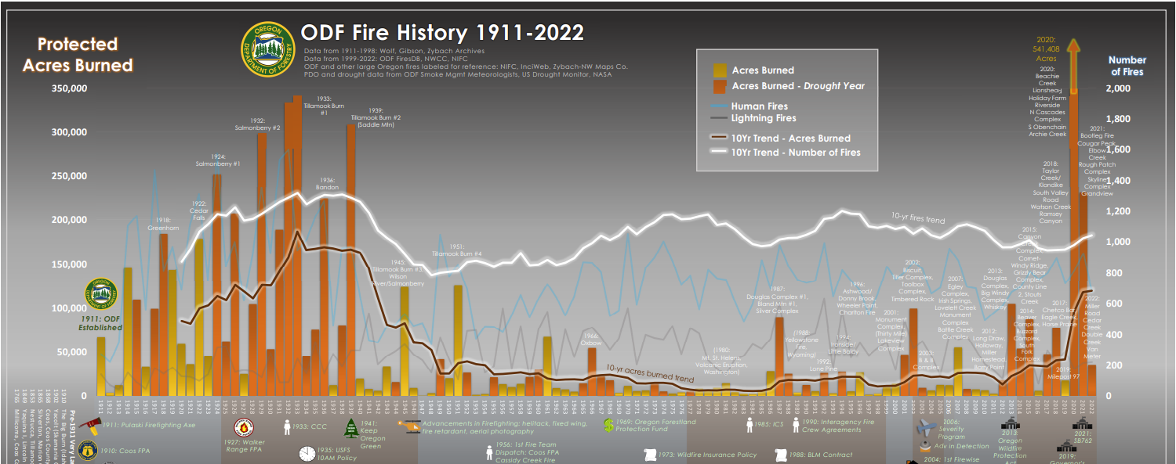
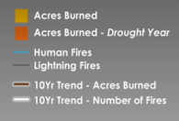
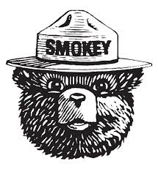
ODF Fire History 1911- 2022
Pacific Decadal Oscillation
10-year trend # Fires
10-year trend Acres burned
1910
1920
1930
1940
1950
1960
1970
1980
1990
2000
2010
2020
PDO Cool
PDO Warm
PDO Cool
PDO Warm & Global Warming
https://www.oregon.gov/odf/fire/documents/odf-century-fire-history-chart.pdf

Slide 31

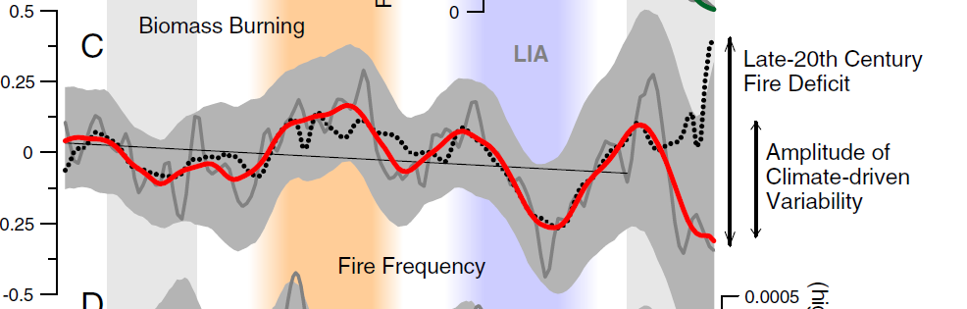

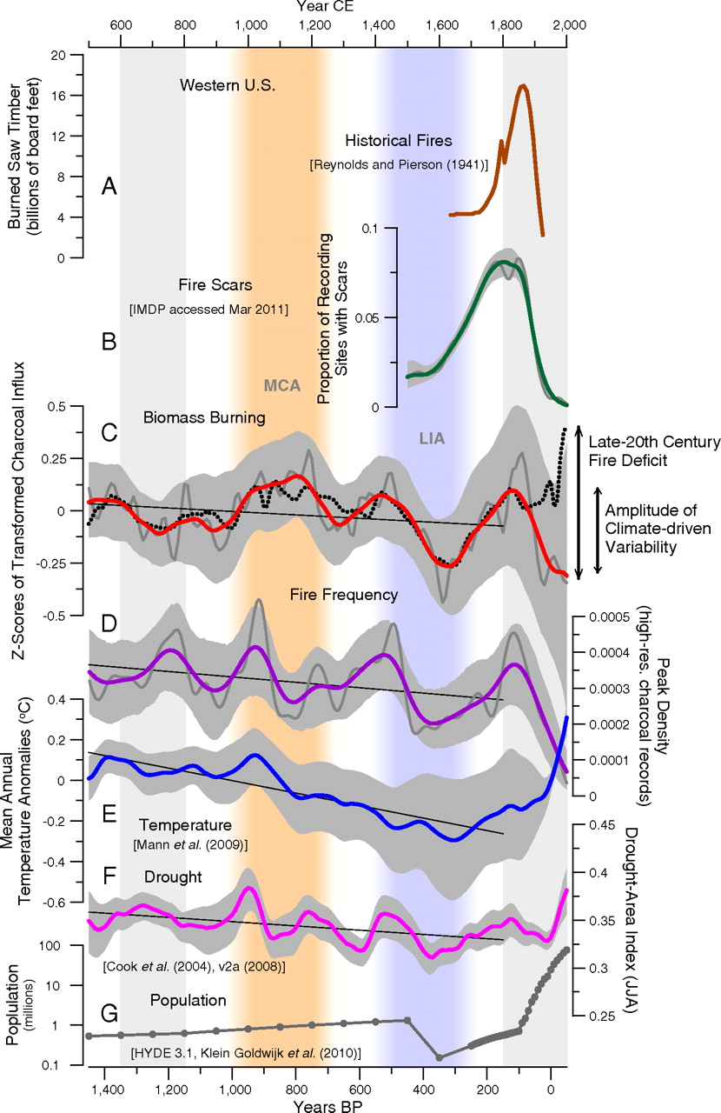
Relative changes in forest area burning in the western United States: 1400 yrs.
Forest burning
100-year trendline (red)
Forest burning records (gray)
Little Ice Age
Amplitude of climate-driven variability
Modeled forest burning based on climate
Jennifer R. Marlon et al. PNAS 2012;109:E535-E543
https://www.pnas.org/doi/abs/10.1073/pnas.1112839109

Slide 32
Relative changes in forest area burning in the western United States: 1400 yrs.
Forest 100-year trendline (red)
Forest burning records (gray)
Little Ice Age
Late 20th Century
Fire Deficit
Amplitude of climate-driven variability
Modeled forest burning based on climate
Climate Change is increasing the wildfire risk
Jennifer R. Marlon et al. PNAS 2012;109:E535-E543
https://www.pnas.org/doi/abs/10.1073/pnas.1112839109

Slide 33
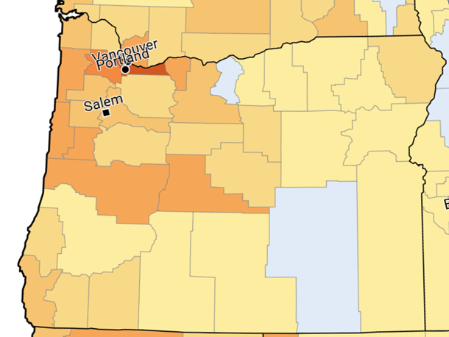

Estimated % of Oregonian adults who are somewhat or very worried about global warming (nat'l avg. 63%), 2024
Multnomah
Sherman
Harney
https://climatecommunication.yale.edu/visualizations-data/ycom-us/

Slide 34
Oregon Climate Future Implications
QUESTIONS?
QUESTIONS?
Alan Journet
Cofacilitator, Southern Oregon Climate Action Now
alan@socan.eco; 541-301-4107

