Slide 1
Ninth Power Plan for the Northwest
Jennifer Light
Director of Power Planning
March 16, 2026

Slide 2
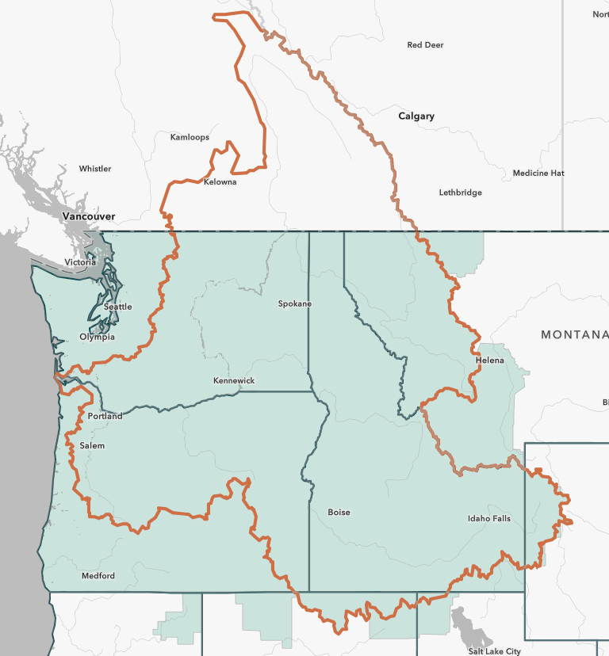
Northwest Power and Conservation Council
Authorized by Congress through the Northwest Power Act of 1980
Council appointed by the governors of Idaho, Montana, Oregon, and Washington
Key responsibilities include:
Develop a program to protect, mitigate, and enhance fish and wildlife affected by the hydro facilities
Develop a power plan to assure an adequate, efficient, economical, and reliable power supply
Inform and involve the public in these planning efforts

Slide 3
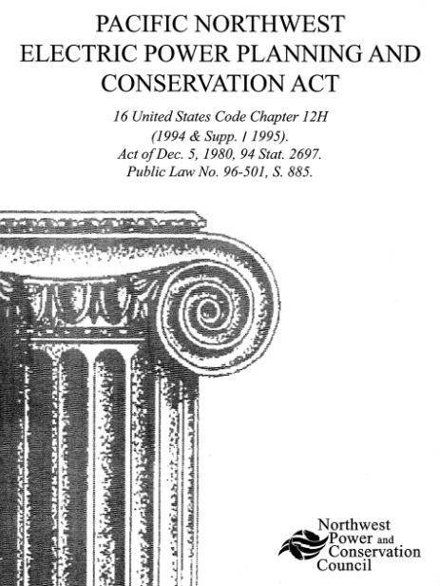
Power Act Guides the Council’s Power Planning
Prepare a regional conservation and electric power plan
Give priority to cost-effective resources, with first priority to conservation, then renewables, then to generating resources utilizing waste heat, then all other resources
Include a scheme for “implementing conservation measures and developing resources … to reduce or meet the Administrator’s obligations…”
Council must give “due consideration” to:
Environmental quality
Compatibility with the existing system
Council’s Fish and Wildlife Program
Other criteria the Council might set forth in the plan

Slide 4

Developing Ninth Power Plan
Council kicked-off its formal review of the Power Plan in February of 2025
Goal is to ensure an adequate, efficient, economical, and reliable power supply, while balancing all the considerations required by the Power Act
Focused on the electric system
Provides a 20-year perspective, with a near-term focus
Aims for a resource strategy, and supporting recommendations to meet regional needs while managing costs and risk
Will include recommendations for the region, but with particular focus on Bonneville

Slide 5

Timeline
Draft – Subject to Change

Slide 6
Key Questions for this Power Plan
Scenario Modeling
Uncertainty Represented by Futures
New Resource and Transmission Risk Scenario
Changing Hydro Operations Scenario
Extreme Weather
Load Growth Uncertainty
Informing how resource selection changes with uncertainty around new resource availability and costs and a changing transmission landscape
Informing how the uncertainty around future hydro operations impacts the optimal resource solutions for the region
Developed a suite of futures to reflect a range of hydro conditions, temperatures/loads, and wind conditions
Developed a suite of futures to reflect uncertainty around the amount, shape, and timing of new load growth
Estimating 13 sensitivities to explore these uncertainties
100s model runs to represent these uncertainties

Slide 7
New Resource and Transmission Risk Scenario
Constrained Resources and Transmission
Explores resource options if supply side resources are constrained in the near-term, there is no new transmission, and emerging tech is delayed
Changing Transmission Availability
Explores resource development assuming three different transmission buildouts, leveraging public information from the WestTEC effort
Changing Emerging Technology Costs
Explores impact of uncertainty of emerging technology costs through both a study of decreased costs (25% less) and increased costs (50% more)
Limited Short-Duration Storage Availability
Explores how resource buildout changes if short-duration storage availability is limited in the near-term across the west
Slower Demand Side Resource Availability
Assumes energy efficiency, demand response, and rooftop solar take longer to develop than what is technical feasible
Evolving Federal Policy Landscape
Explores how changes in Federal policies impact resource decisions in the region, with a focus on tax credits and natural gas requirements

Slide 8
Changing Hydro Operations Scenario
2020 BiOp Flex Spill Operation
Assumes operations based on the 2020 CRSO EIS to represent “current operations” and provide a basis for comparison
2023 RCBA Operation
Given uncertainty around 2026 operations, uses RCBA defined spill operations to represent a “steady spill” option as a point of comparison
Recommended Spill and MOP Targets
Analyzes specific minimum operating pool elevations and limits and spill operations recommended by some of the states and tribes into the F&W Program amendment process
Limited Flex Operation
Analyzes power system implications of limiting the hydro system’s ability to change daily elevations and outflows
This scenario was scoped in August 2025 reflecting uncertainty around future operations and exploring recommendations submitted to the Council as part of its fish and wildlife program amendment process.

Slide 9




Approach to Futures in the Ninth Plan
Futures capture uncertainty and volatility around:
Council uses three climate models to guide the range of futures for loads, hydro flows, and renewable profiles
We also developed a range of natural gas prices and approach to accounting for natural gas price volatility
Collectively, these uncertainties represent over 13,500 future trajectories that guide our modeling
Load Growth
Hydro Flows
Wind and Solar Profiles
Natural Gas Prices & Volatility

Slide 10


Modeling Enhancements for Ninth Plan
Understand impacts of load growth unique to specific geographic areas
Explore trade-offs between transmission development timelines and new resources
Assess the locational value of resources
Enhanced analysis of weather impacts on resource availability
Analyze the effect of end-use demand profiles at critical peak times
Explore cost and risk of proposed portfolios’ hourly operations implications
Modeling 17 Zones
Hourly Analysis
Location
Timing

Slide 11
Power Plan Process Flow
Environmental Methodology
New Generating Resource and Distributed Energy Resource Options, Energy Efficiency and Demand Response Supply Curves
We are here!
Market Availability Forecasts
Fuel Price Forecasts & Global Assumptions
Scenario Analysis for Resources and Reserves
Resource Strategy Development
Electricity Demand Forecasts
Needs Assessment
Fish & Wildlife Program
Existing System Parameters & Policies

Slide 12
Next Steps in Developing the Ninth Plan
Feb
Mar
Apr
May
Jun
Wrap up modeling →
Discussing results with Council→
Preparing the draft power plan →
Jul
Aug
Sep
Oct
Nov
Releasing the draft
Public comment period →
Finalize Ninth Plan→

Slide 13
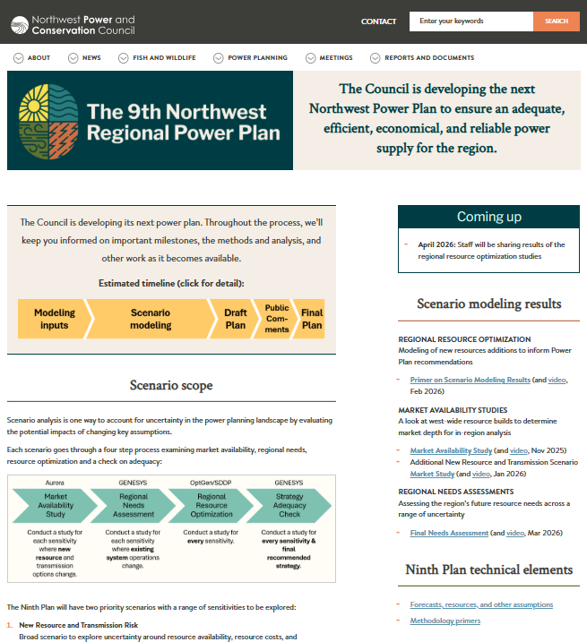
For More Information
All material is available on the Council’s Ninth Power Plan webpage: https://www.nwcouncil.org/energy/ninthpowerplan/
Council will continue to work in public via its regular meetings and advisory committee meetings
Reach out with any questions

Slide 14
Additional Slides

Slide 15
Load Forecast

Slide 16
Load Forecast Approach for Ninth Plan
Developed five pathways of load growth reflecting a range of assumptions across different sectors to account for uncertainty in timing, size, and shape
Temperature data from three climate models are then used across each of these trajectories to ultimately create 15 futures
All forecasts represent a “frozen efficiency” view, allowing the models to optimize the demand-side resources
Pathways | Economics | Transportation | Data Centers | Building Electrification | Hydrogen
Persistent high growth | Medium | Higher | Higher | Higher | Higher
Persistent low growth | Lower | Lower | Lower | Lower | Lower
Early growth | Medium | Lower | Higher | Lower | Lower
Late growth | Medium | Higher | Medium | Higher | Higher
Mixed bag | Medium | Higher | Medium | Lower | Lower

Slide 17
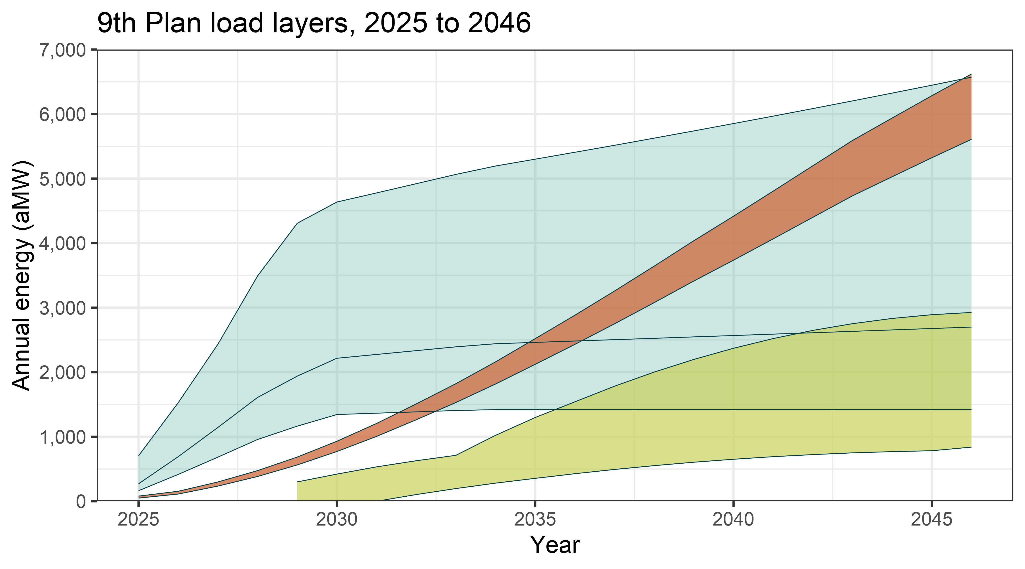
Load Forecast, Key Sectors
Tech and transportation electrification can reach similar levels by 2046
Transportation
Tech load forecast
Hydrogen

Slide 18
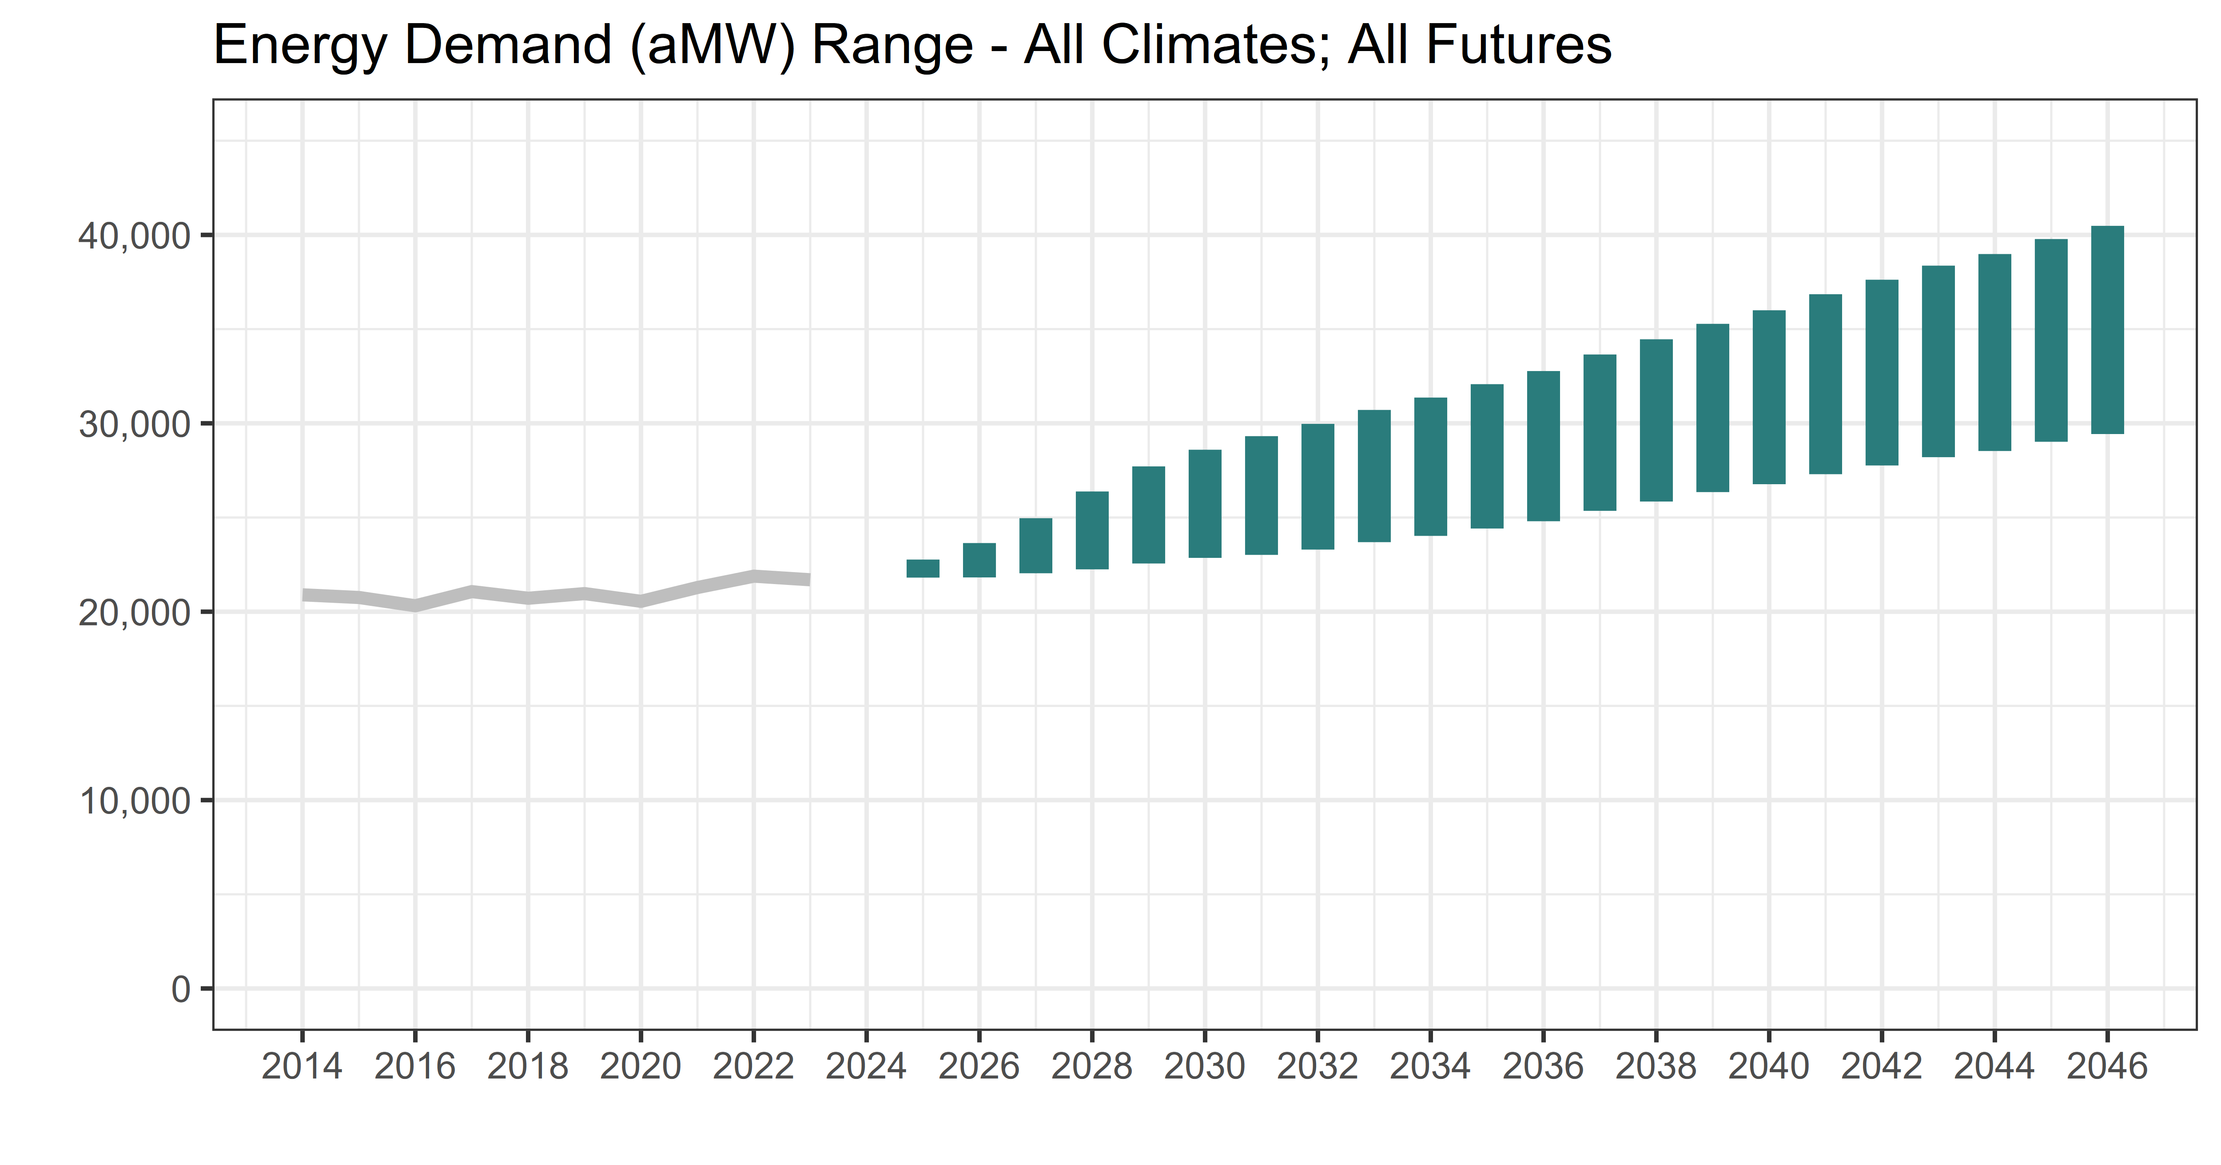
Load Forecast, Energy
High range of bars represents the high growth pathway
Low range of bars represents the low growth pathway
Actual loads have been flat to slightly growing in the past 10 years

Slide 19
New Resource Options

Slide 20

Generating Resources Considered
Primary
Utility Scale Solar PV
Renewables + Storage
Limited Availability
Conventional Geothermal
Emerging Technology
Onshore Wind
Small Scale Renewables
Gas Combined Cycle
Gas Simple Cycle
Battery Storage (Li-Ion)
Offshore Wind
Pumped Storage
Biomass
Hydro Upgrades
Biogas
Small Hydro
Combined Heat and Power
Clean Baseload
Clean Long Duration Storage
Clean Peaker/Medium Duration Storage
Generating resources explicitly modeled

Slide 21
Conservation Potential
Most res and com ETs, many res HVAC measures
Distribution system ETs, some res HP upgrades, grocery refrig., more DOAS
Efficient air compressors, some DOAS measures, some efficient windows
HPWHs, efficient res AC, many ag measures, efficient dryers, some res Wx
Much of res Wx
Industrial SEM, Some pumps, Engine block heater controls
ENERGY STAR Clothes Washers, TVs
HP retro-Cx

Slide 22
Potential Includes Emerging Technologies for Some of the Sensitivities

Slide 23
Emerging Technology Potential Provides Options for Consideration in Outer Years

Slide 24
Demand Response Products
HVAC switches & thermostat controls
Water heating controls
Pricing programs, including time of use programs
Electric vehicle programs
Battery management
Demand curtailment
Irrigation Control
Demand Voltage regulation

Slide 25
DR Supply Curve

Slide 26
Market Availability

Slide 27
Market Availability High-Level Findings
Market availability does not change significantly across the various sensitivities
The 20-year buildouts are remarkably similar
The near-term buildouts shift a bit, primarily where there are limitations in resource (and particularly short-duration storage) availability)
Key drivers of the builds are state policies, specifically carbon pricing in California, Washington, and Canada and demand growth
Majority of resources built across all sensitivities are a balance of renewables, storage (both short and longer duration), and gas
Buildouts and implied prices indicates that the economics of the market is likely to be very different from previous recent studies
Given the similarity across buildouts, the differences in these market studies is not expected to be a significant driver of differences in regional resource buildouts in the next step

Slide 28
All Sensitivities

Slide 29
System Needs in 2031

Slide 30
System Needs are Longest and Largest in Winter and Summer

Slide 31
Final Planning Reserve Margin - Peak

Slide 32
Final Adequacy Reserve Margin - Energy

Slide 33

Feel free to connect!
Jennifer Light, jlight@nwcouncil.org
www.nwcouncil.org/energy/ ninthpowerplan/

