Slide 1
An Electric System Transition Strategy
Presented to
Engineers for a Sustainable Future
Dr. Pat DeLaquil
Mobilizing Climate Action Together (MCAT)
May 12, 2026

Slide 2
An Electric System Transition is Needed/Imminent
Affordability is the critical factor
The existing central-station utility paradigm is at a breaking point because its size is driven by peak loads, which are minimally managed.
Our near-term focus should shift to making greater use of the existing electric grid infrastructure that we already have in place.
Current utilizations is only about 40%, which means that we currently only use the system at full capacity during the hottest days in the summer.

Slide 3
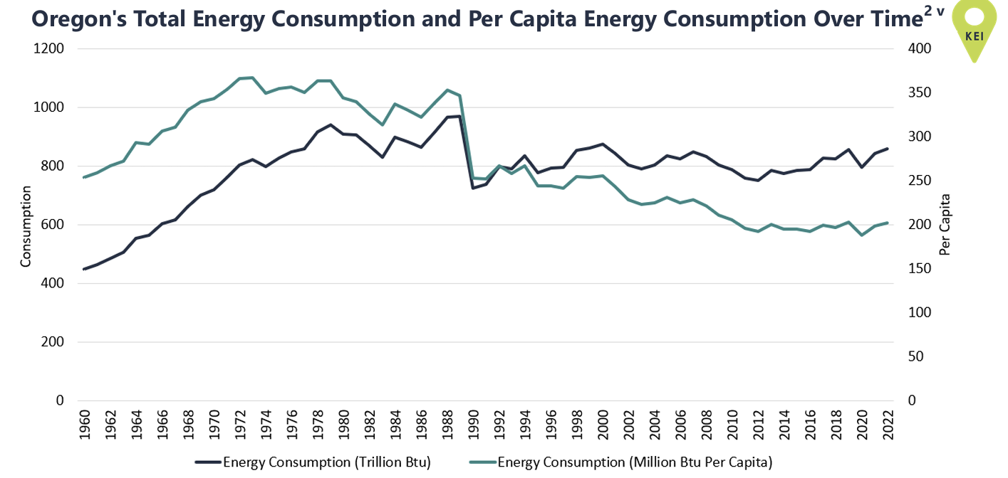
Energy Efficiency Has been a Key to Affordability
In the last 30 years, Oregon’s population has steadily increased while overall energy consumption has slightly declined, driven by energy efficiency savings – from ODOE Biennial Report.

Slide 4
Improving System Utilization with Clean Energy
Greater utilization of our existing transmission and distribution grid assets defers the need for expensive transmission expansion projects
Technology is now available to flatten peak loads using coordinated networks of distributed energy resources that are managed collectively to balance energy supply and demand, delivering reliable grid services like a conventional power plant.
Called virtual power plants (VPPs), they provide a coordinated way to shift large amounts of power out of peak demand periods and can be deployed during emergencies for local grid resilience.
VPPs and other approaches that increase utilization of exiting grid infrastructure, lower costs for all customers by avoiding new transmission buildouts and spreading fixed costs for the existing infrastructure over a larger number on kilowatt-hours.
The Brattle Group estimates that VPPs cost 40-60% less than other energy sources and widely deploying VPPs across the country could save up to $35 billion for ratepayers by 2030 (Brattle).

Slide 5
Strategic Overview
Electric System Transition Strategy
Transmission System Components
Distribution System Components
Grid Enhancing Technologies
Advanced Conductors
Efficiency and Demand Response
Distributed generation and storage
Regional Transmission Planning
Grid-scale RE Project Planning
Virtual power plants
Performance Based Regulation
Nested Grid Architecture

Slide 6
Transmission System Transition Strategy
Transmission System Components
Grid Enhancing Technologies
Advanced Conductors
Implementation of GETs and Advanced Conductors
Develop regional planning structures for project development and transmission planning
Regional Transmission Planning
Regional Project Planning
Commission a study to examine benefits of nested grid architecture relative to the existing large synchronized grid model
Nested Grid Architecture

Slide 7
Transmission System Transition Strategy

Slide 8
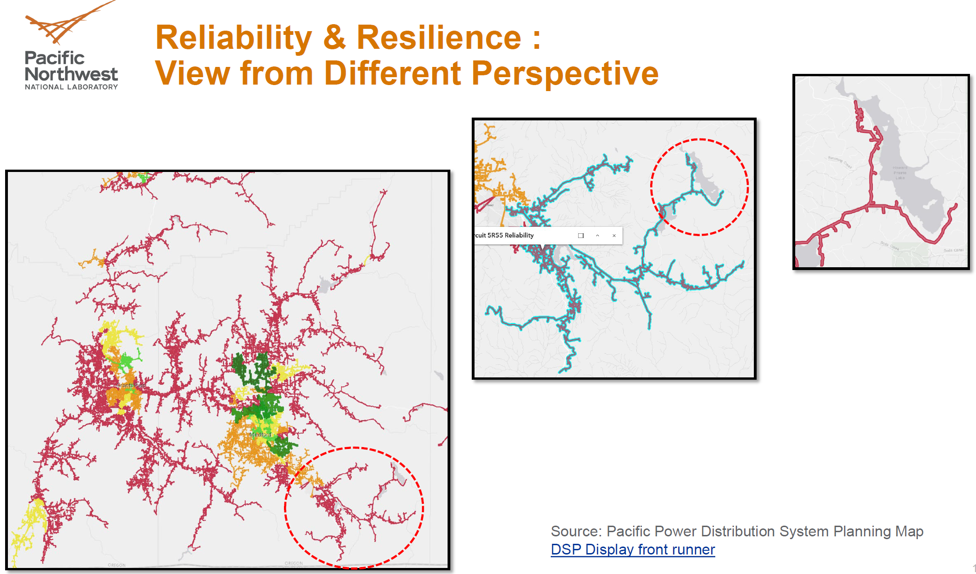
Illustration of Nested Grid Architecture-1

Slide 9
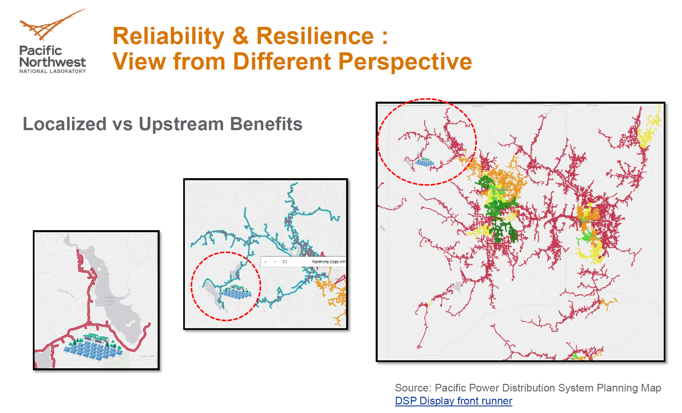
Illustration of Nested Grid Architecture-2

Slide 10
Distribution System Transition Strategy
Distribution System Components
Solar Permitting Reform
Balcony Solar Allowed
Community Solar and CBREs incentivized
Distributed generation and storage
Inclusive Utility Investment Implemented
Leverage PCEF HP incentives
DR & Resilience Incentives enabled for LMI households
Efficiency and Demand Response
Virtual power plants
Direct utilities to develop a market for VPP Services
Performance Based Regulation
Reward utilities for developing a market for VPP Services

Slide 11
Distribution System Transition Strategy

Slide 12
Questions and Discussion
Input to the strategy is welcome
Contact me at pdelaquil@gmail.com

Slide 13
Back-up Slides

Slide 14
VPP Issues
Lack of Market Price Signals
VPP programs in New York, Massachusetts, and California have energy markets that set prices allowing VPP aggregators to directly compete in these markets
Can we identify a basis for compensation rates for participating aggregators based on the estimated value of each resource to the system and cost to participate
Past experience with programs such as Community Solar have shown it is extremely difficult to reconcile program structures that are both cost-efficient and drive third-party participation

Slide 15
Remove Barriers to Distributed Resources Through Innovative Utility Financing
Inclusive Utility Investments, or Upgrade as you Save
Facilitates greater energy efficiency and increase utilization of VPP’s by helping households and small businesses access clean technologies without facing prohibitive upfront costs
Proposed Pilot program will unlock savings and help households generate benefits to the overall electric system, including reduced energy demands, peak load reductions, grid supports, and system resilience.
The Pilot would allow Investor-Owned Utilities to provide funds for energy efficiency and strategic electrification without additional burden to the General Fund or ratepayers.
Need to develop responses to OPUC concerns on the bill

Slide 16

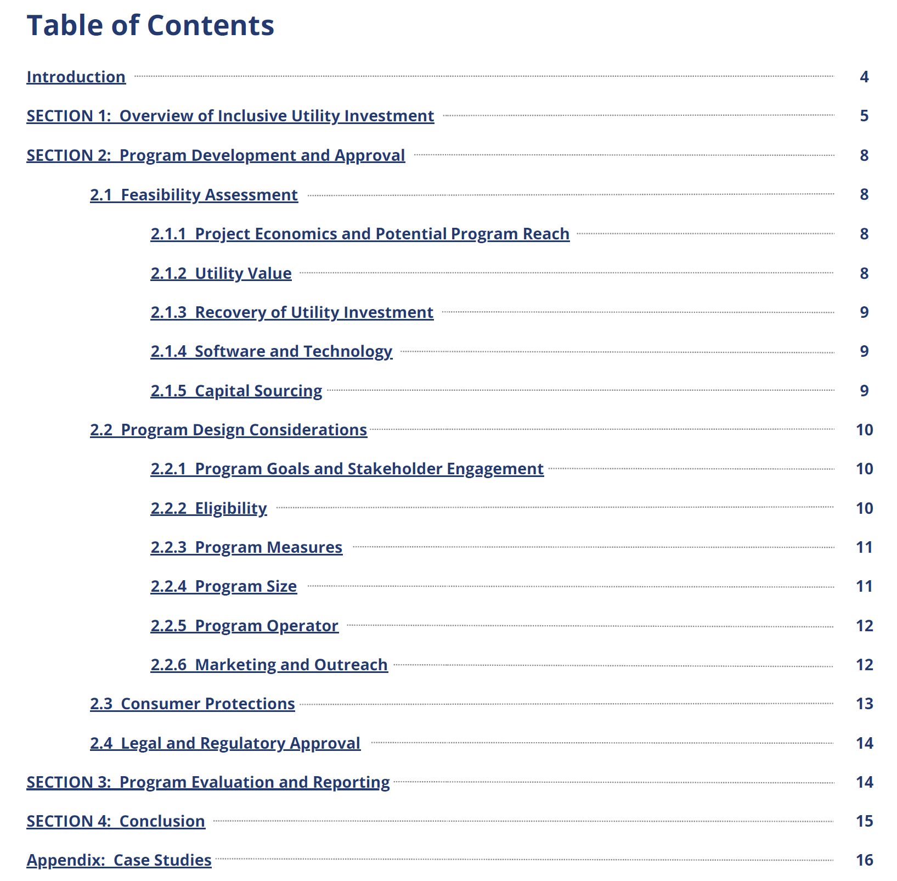

Slide 17
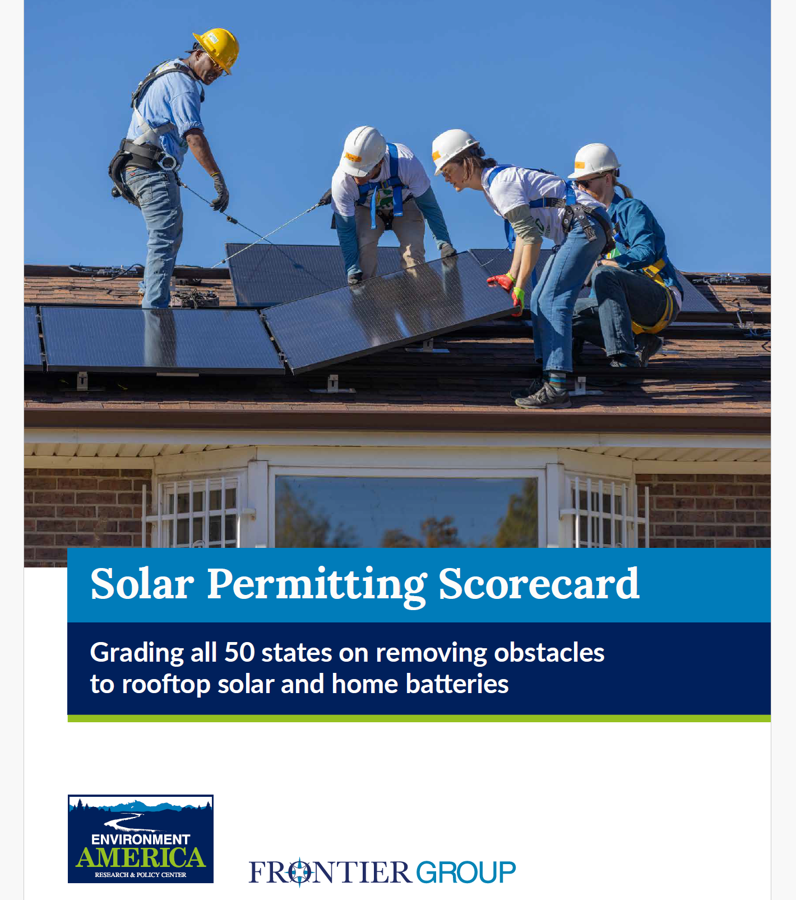
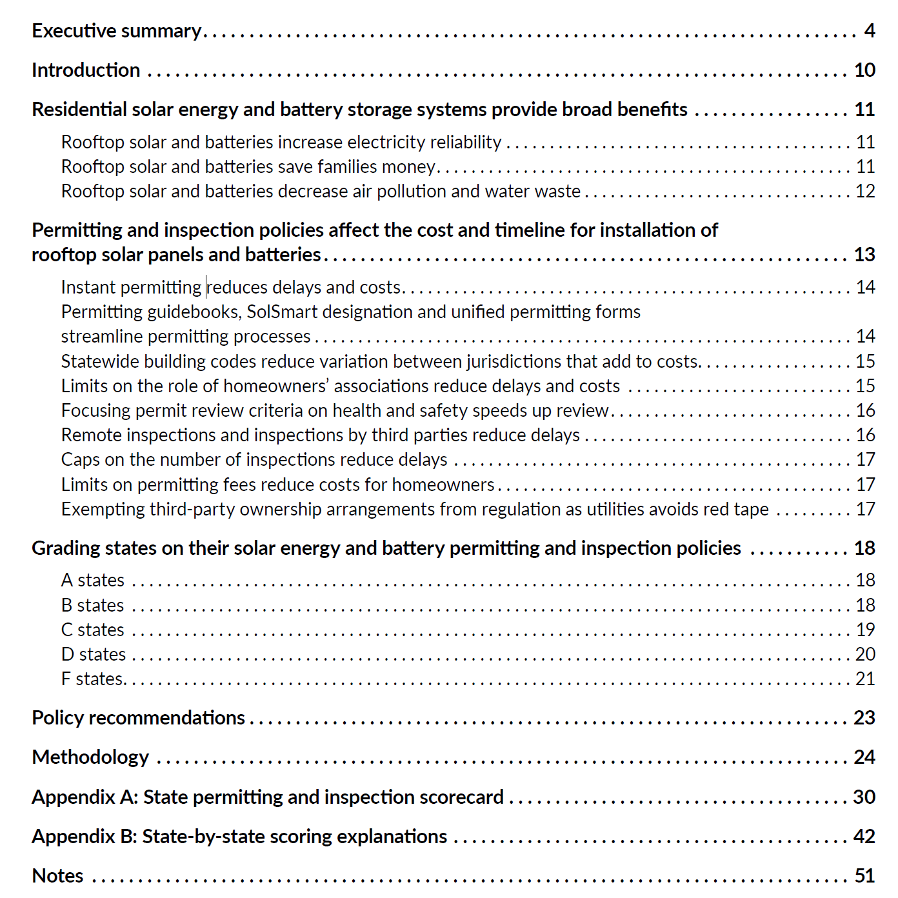
Solar Permitting Reform

Slide 18
Balcony (Plug-In) Solar
A niche technology that opens up a large market for small-scale solar panels
Some certification and code issues need resolution
Passed with bipartisan support in Utah (2025) and Virginia (2026)
Electricians and firefighters were mobilized against the bill in Oregon
Need to work on getting these groups neutral as issues can be handled
MCAT and Third Act were key proponents
Virginia to become second state that allows balcony… | Canary Media

